Slide 1
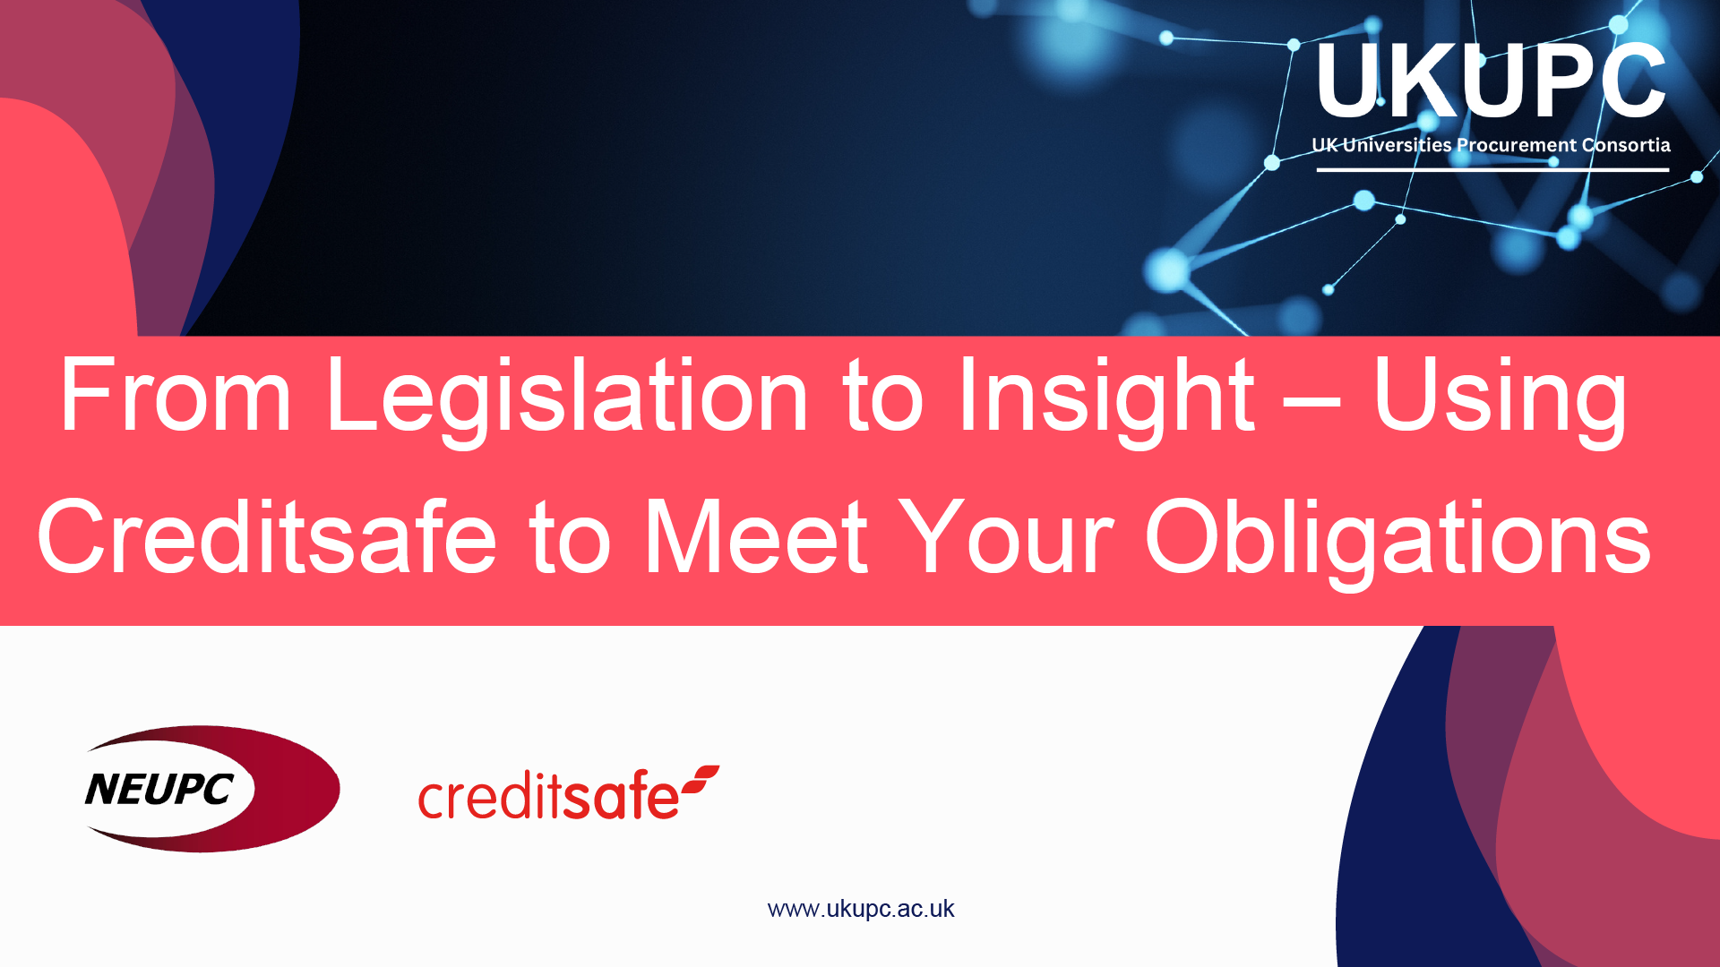

Slide 2
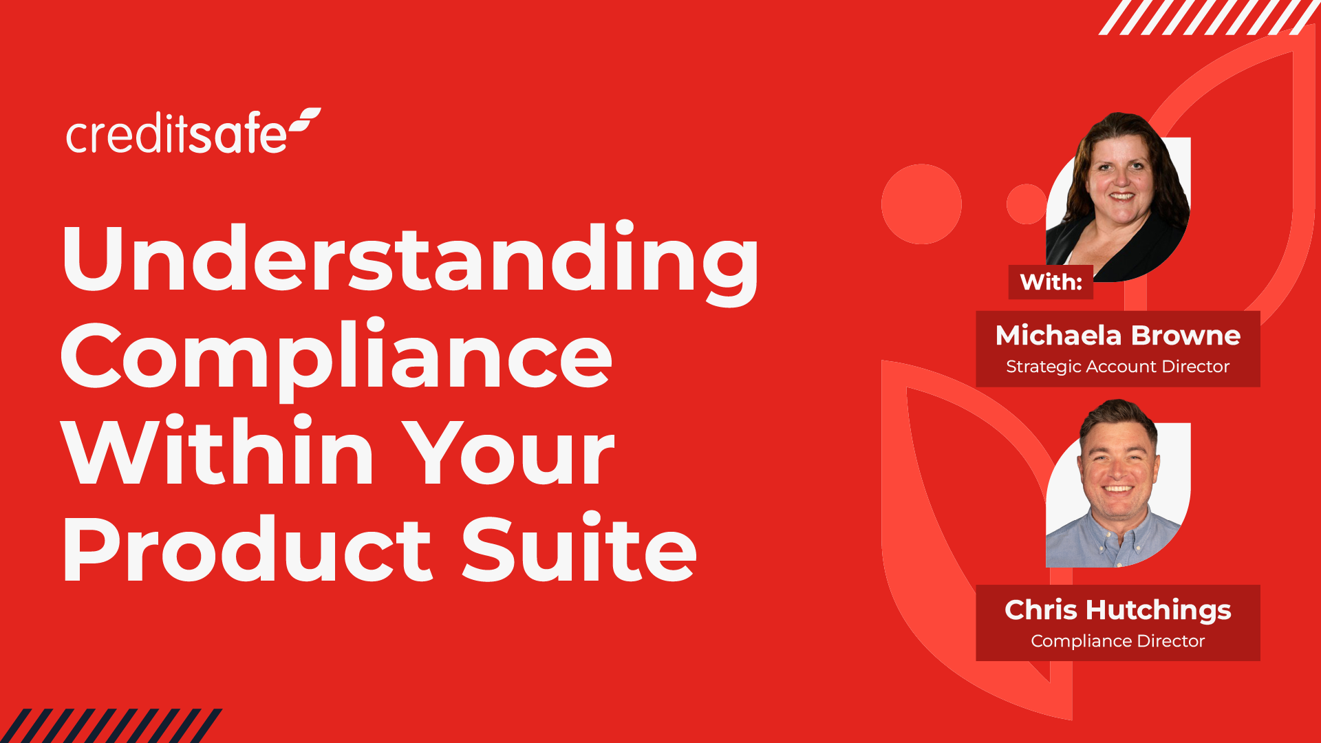

Slide 3
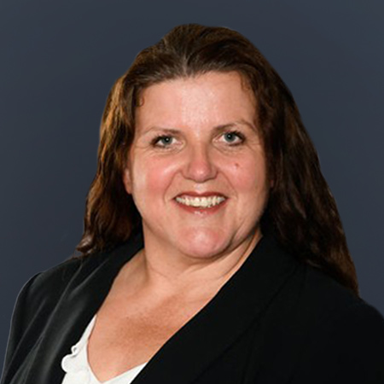

The Team Today
Michaela
BROWNE
Chris
HUTCHINGS
Strategic Account Director
Compliance Director
Over 24 years experience within the credit industry.
Provides dedicated support and solutions across many industries.
12 years experience within the compliance sector.
Expert in compliance, working with teams to develop a strong portfolio of solutions.

Slide 4







Global Business Intelligence Experts
430+ million online business reports from 200 countries and territories available instantly.
Creditsafe is growing over
10% each year on average.
We are proud to serve over
120,000 customers across
3 continents.
Our reports are powered by over 9,000 global data sources
Over 1.3 million unique corporate groups with 5.2 million linkages
You can monitor businesses
in over 45 countries.

Slide 5




















The Complete Business Intelligence Solution
Sales
Onboarding
Credit Control
Collections
Customer Relationship Management
Find new customers.
Automate credit decisions.
Analyse the financial performance of all public and private companies.
Prioritise collections.
Accurate data on all your customers.
Automatically update your sales CRM.
Verify bank details and ID check individuals instantly.
See how companies pay other businesses for similar products or services.
Understand individual customer payment trends.
Manage changes automatically without manual data entry.
Receive alerts about prospects and customers.
Speed-up your on-boarding process.
Review the likelihood of any company becoming insolvent.
Monitor your cashflow and receive alerts for changes.
Bespoke targeted business data.
Identify up-sell and cross-sell opportunities.
Protect against fraud, corruption and reputational damage.
Receive real-time alerts about CCJs and insolvency orders.
Reduce payment times and late payers.
Monitor customer credit, legal, and sanction status.

Slide 6
What is Compliance?

Slide 7


KYC Protect
Accelerate customer due diligence and make decisions in minutes with our end-to-end due diligence platform.

Slide 8
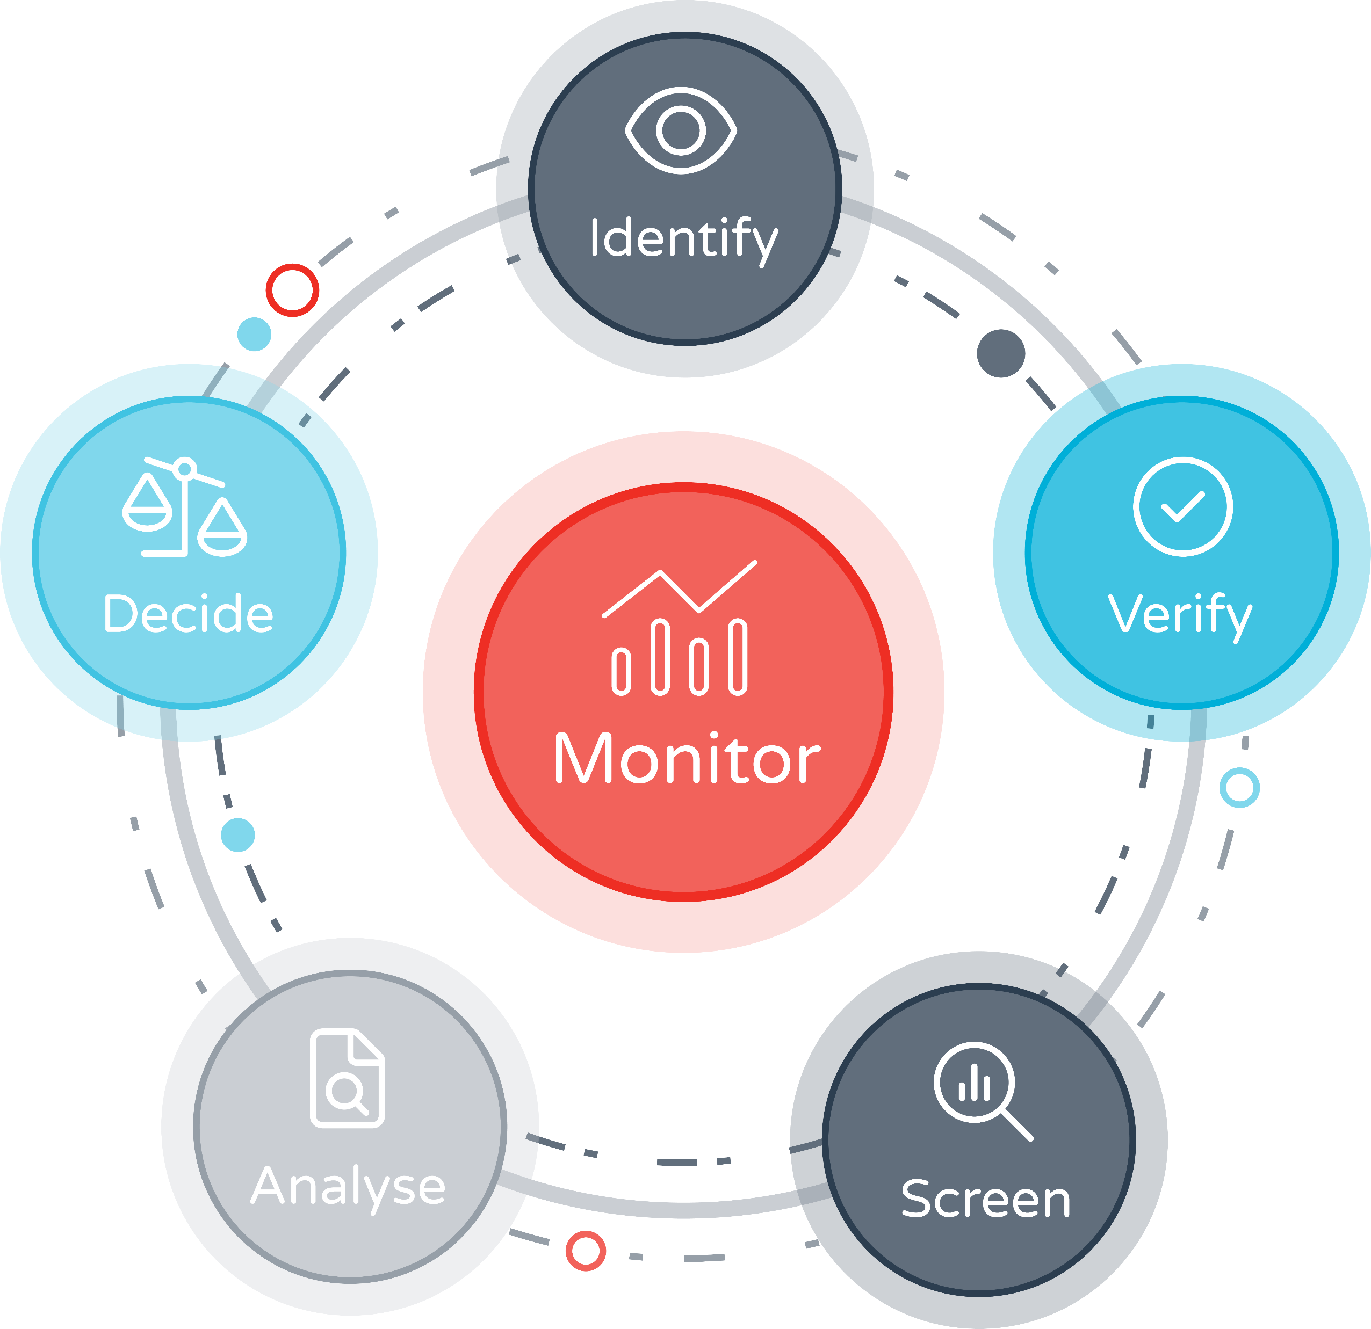


KYC Protect
Use KYC Protect to identify, verify, screen, analyse and monitor your commercial relationships.
KYC Protect centralises all your core Know Your Customer (KYC) and Anti-Money Laundering (AML) obligations in a single, easy-to-use solution.
Why KYC Protect?
End-to-end KYC solution:
Identify key parties, group structures and UBOs; Automate screening and monitoring of changes in business, financial and AML for a complete solution.
Real-time alerts across all your departments:
Broadcast compliance and business risk alerts and prevent users across all departments and subsidiaries from doing business with sanctioned or dubious companies.

Slide 9
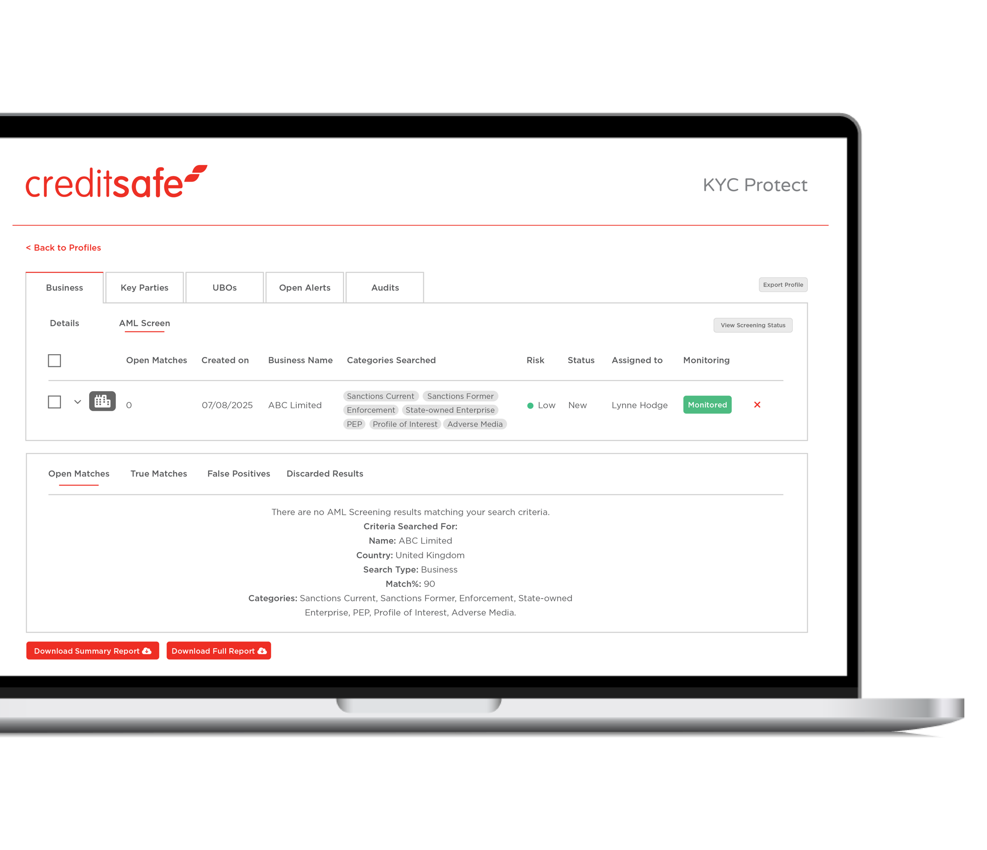








KYC Protect
Powered by Acuris Risk Intelligence
A single search connecting you to global sanctions, enforcement lists, PEPs and media sources.
Sanction lists include: OFAC, EU, UN, BOE, FBI, BIS and more.
Enforcement lists include: FDA, US, HHS, UK FSA, SEC and more.
1.6m | PEP records | 707k | Reputational risk exposure sources
200+ | Countries & territories | 100% | Global sanctions & enforcement lists covered
5.3m | Profiles in the database | 4.8k | Additions or updates every day
Screen against these risk categories:
Sanctions |  | State-owned Enterprise
Enforcement |  | Profile of Interest
PEPs |  | Disqualified Director (UK only)
Adverse Media |  | Insolvency Register (UK only)
Please note: Profiles are continuously added

Slide 10



KYC | PEPs & Sanctions
Establish who the directors, shareholders and UBOs are in a business using data from Creditsafe’s global business reports.
Access 430m company reports in over 200 countries and territories.
1.4m group structures across 5.4m corporate linkages globally.
Use ownership, shareholder and business data from our company reports to auto-create profiles.
Select the KYC data that’s relevant to your checks.
Upload your documents and data so you have everything in a single location.
With an average of 50% fewer false positives, resources can address actual threats.
Target risks to your business using sanction type and PEP tier filtering.
Batch upload names of individuals and businesses you want to screen.
Identify & Verify
Identify and verify key controllers in seconds
Screen
Instant profiles for screening and monitoring
Analyse
Focus on
genuine risks

Slide 11
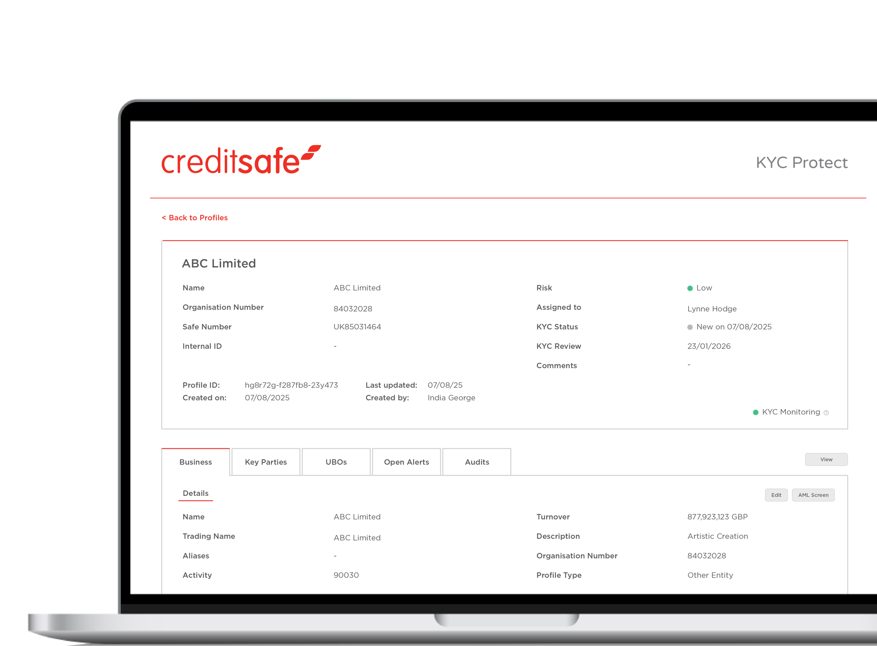


KYC | PEPs & Sanctions
Get a clear overview of profiles, track case status and collaborate with colleagues.
Frictionless workflows enable you to assign cases for review or approval.
Retrieve a record of all actions taken on a profile with a full digital audit trail.
Receive emails and in-product notifications when changes occur.
Access AML monitoring in over 200 countries, covering global sanctions, watchlists, PEPs profiles and adverse media.
Access KYC monitoring in over 45 countries, covering changes to company registration details, status, directors, financials and negative information
Decide
Be decisive about who to do business with
Monitor
Monitor changes to risk status as they happen

Slide 12








KYC Protect
Speed Up Due Diligence
Search company reports, create profiles, screen parties, monitor and make audited decisions in minutes.
Effortless Batch Screening
Screen up to 50,000 records in a single check by batch-uploading names of individuals and businesses.
Group Structures & Linkages
Access ownership data from 1.4m group structures across 5.4m corporate linkages globally, allowing you to add details of shareholders, directors and UBOs to profile for screening.
Streamlined Reviews & Approvals
Assign profiles to other team members to review or approve, and have a clear breakdown of a case's status to reach decisions quickly and efficiently.
Centralised Risk Data
Easily upload data to profiles and access all relevant risk information in one place.
Advanced Filters
Implement precise risk assessment by utilising PEP tiers and filtering by sanction type.
Real-time Alerts
Receive email and in-product notifications for changes to a profile that might impact the risk status of an individual or business.
Full Audit Trail
View a full record of all actions completed on a profile, with a full digital audit trail that can be used as part of an audit or report for regulators.

Slide 13
What can you expect the results to look like:

Slide 14


Anti-Money Laundering
Meet money laundering regulations with real-time AML checks.

Slide 15


Anti-Money Laundering
Transform your onboarding and compliance challenges into a competitive advantage.
Creditsafe's AML checks bring together hundreds of data sources online in an instant, removing the need for physical storage whilst saving you both time and money.
Verify a client’s ID instantly
Screen against global PEPs and Sanction databases to give you the highest protection against terrorism funding, fraud and other unlawful financial activity.
Ensure regulatory compliance
Our Anti-Money Laundering checks meet the standards outlined by the Joint Money Laundering Steering Group (JMLSG) guidance, ensuring peace of mind that your due diligence is fully AML compliant.
Screen against 300+ sources
Instantly cross-reference over 300 data sources to manage and mitigate risk, including Credit Data, International PEPs and Sanctions Lists, Passport and European ID Cards, Electoral Roll, plus household and utility bills.
Increase revenue & efficiency
Get answers in seconds, reducing drop-off rates and keeping new clients happy. Access can also be granted to numerous departments within the business to improve efficiency throughout the entire lifetime of a customer.

Slide 16







What Firms Need To Demonstrate Regulatory Compliance?
Regulated firms undertaking certain financial activities are required to apply risk-based customer due diligence measures to prevent their businesses from being successfully targeted by money launderers or terrorist financiers. Some of these firms include:
Accountancy
Banking & Finance
Credit Institutions
Crypto
Gaming & Gambling
Insurance
Investment
Legal & Solicitors
Real Estate

Slide 17
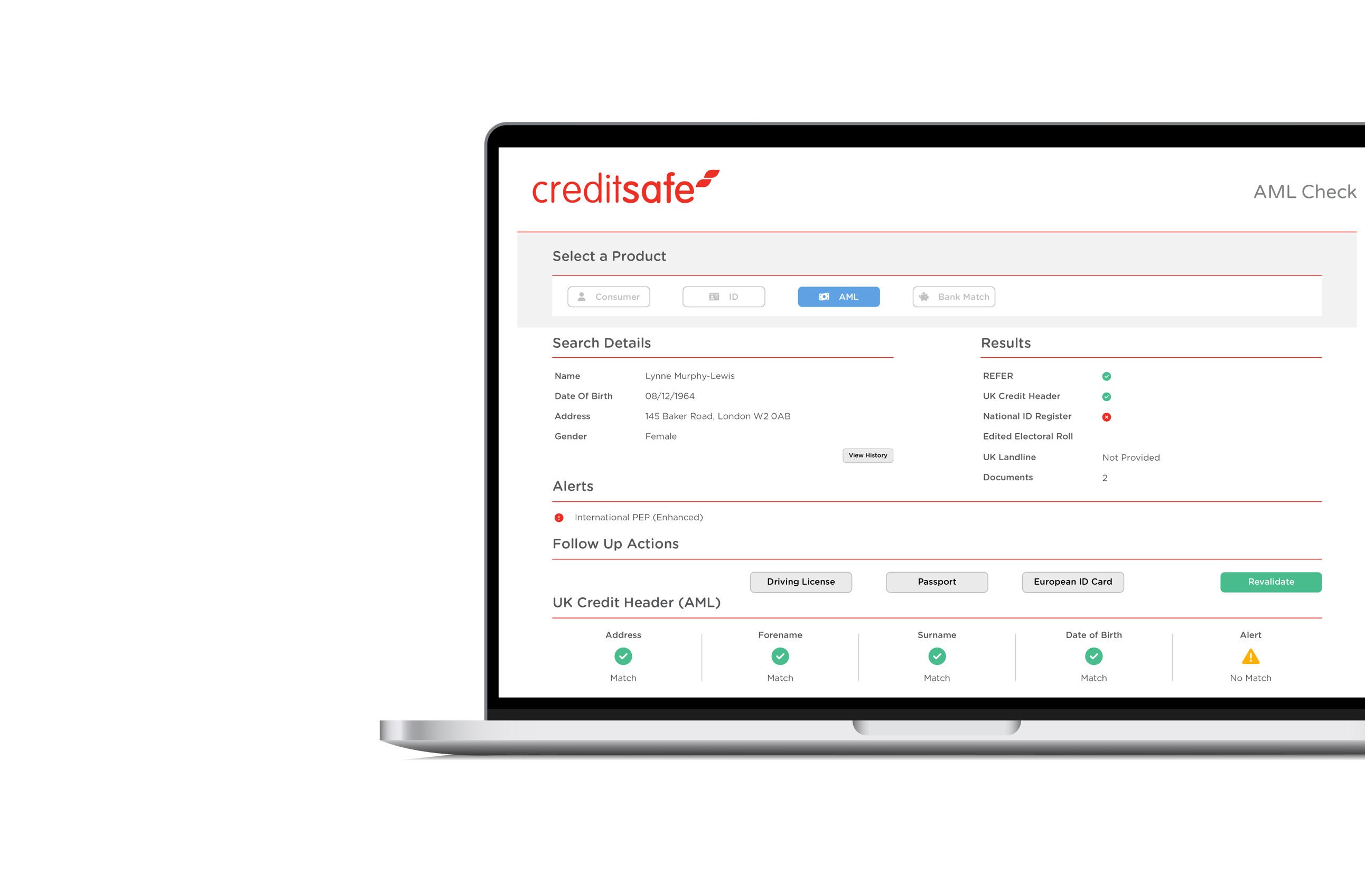



Verify Clients With Proven Multi Bureau Checks
Onboard more ‘good’ customers, securely and quickly, with our multi-bureau solution. Access data from multiple credit bureaus simultaneously in one single solution. Reduce referral rates and onboard more genuine customers without compromising on due diligence.
Fully compliant 2+2 source AML checks
With direct access to two major credit bureaus, our solution delivers more double credit header customer matches, so you can pass more customers straight through at speed with no further checks.
No risk of double counting data sources
Our de-duping technology removes duplicate events from different credit bureaus, maximising the results you can get from this data by combining multiple independent matches.
Easily meet your AML and due diligence obligations
Using two bureaus through a single solution gives extensive coverage across the UK population. Gain additional insights with extra datasets including the Edited Electoral Roll, Mortality, National Change Of Address (NCOA) Database, National ID Register and PEPs & Sanctions.

Slide 18


Enhanced Checks That Deliver Answers In Seconds
Paperless Audit Trail
Reduce costs associated with physical storage, whilst ensuring you are exhibiting good governance with a paperless audit trail stored in a secure environment for 5 years.
Comprehensive Screening
We screen against global PEPs and Sanction databases as standard, helping you to always stay compliant whilst reducing your own company’s exposure to risk.
Bank Data Verification
You can also enrich and enhance your KYC checks by verifying customer bank data via UK bank records, with access to more bank information than any other UK provider.

Slide 19


ID Verification Plus
Effortlessly verify identities with global matching and enhanced compliance checks in just a few clicks.

Slide 20
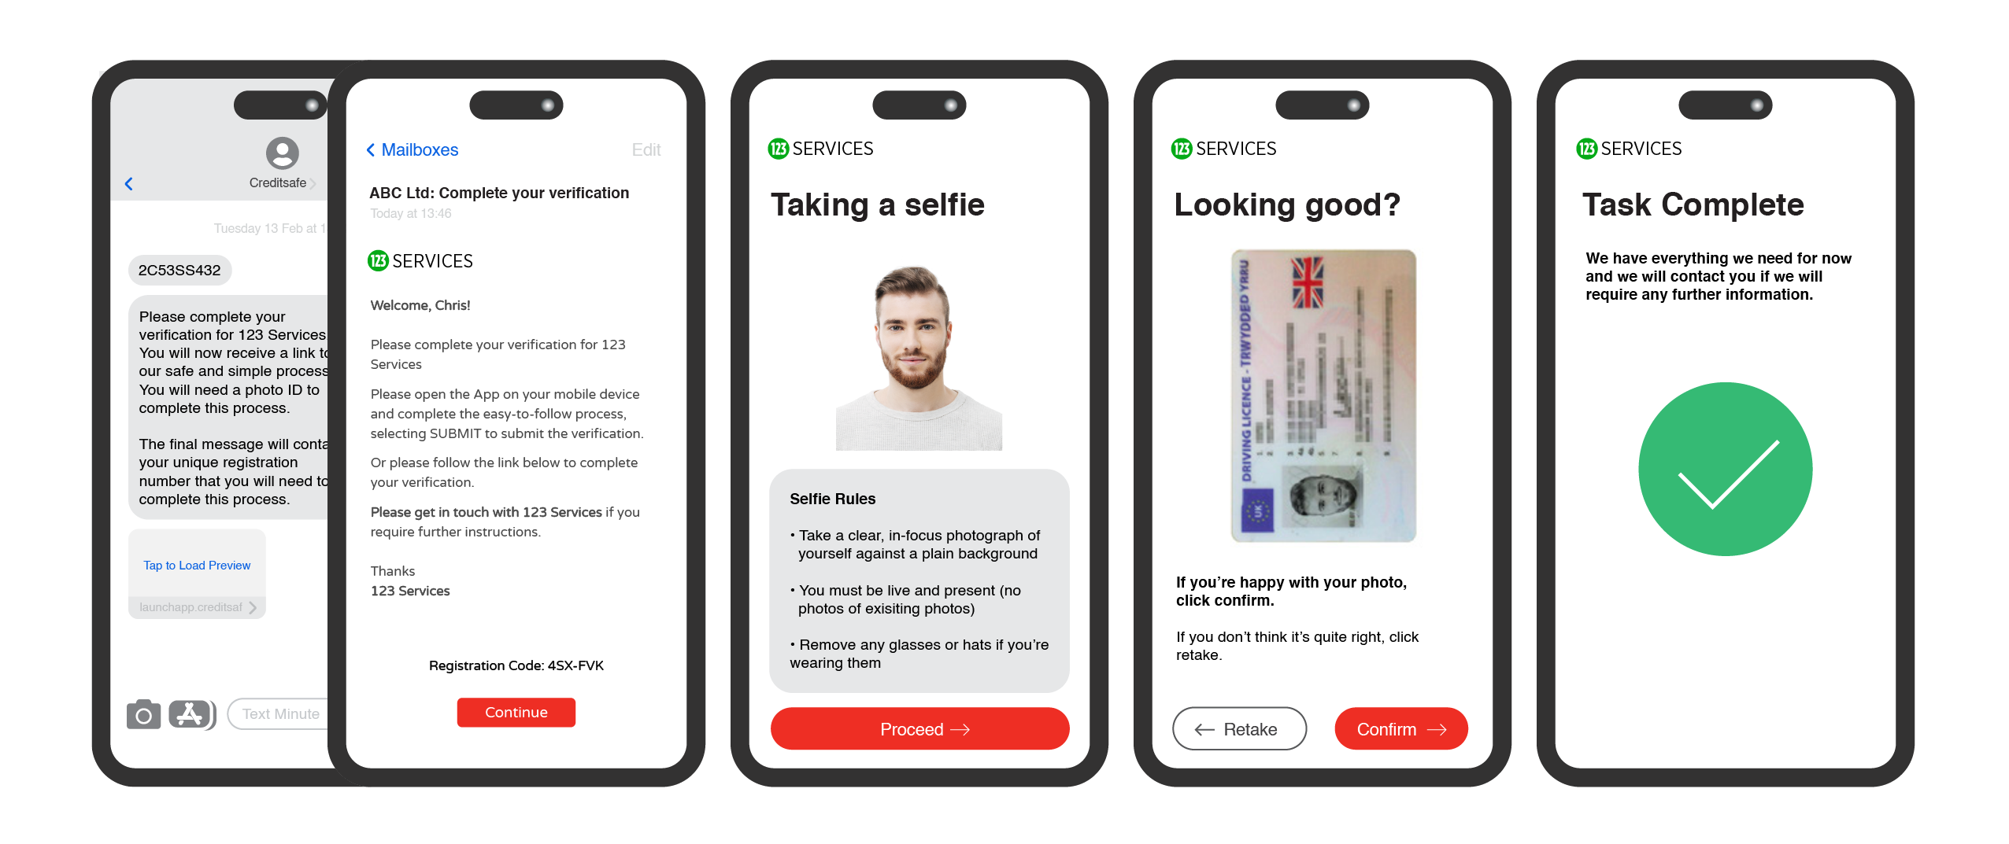
Verified ID Checks In Four Simple Steps
Our ID checking is fast and simple: Send, snap, scan and submit. That’s it.
We remove outdated processes, such as uploading utility bills or bank statements as proof of address, replacing them with data enrichment from verified official sources, such as the electoral register and credit headers.

Slide 21






ID Verification | Types Of Checks
ID Verification
Age Verification
Enhanced AML
Open Banking
Right To Work
Right To Rent
Safe Harbour
Source of Funds
Director Verification

Slide 22
Thank you!

