Slide 1




www.ukupc.ac.uk

Slide 2

NEUPC
Presented by Luke Rennocks
and guest presenters: Simon Roe, Daniel Johnson and Jake Dodds
DHL Express – Excellence. Simply Delivered.

Slide 3


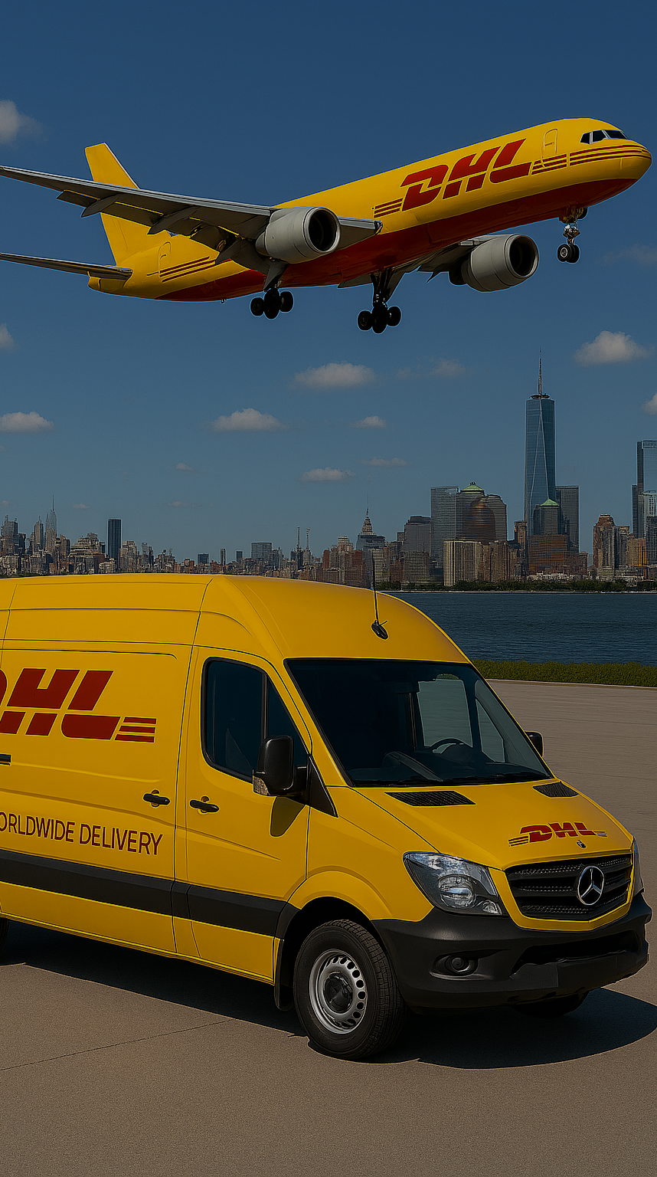
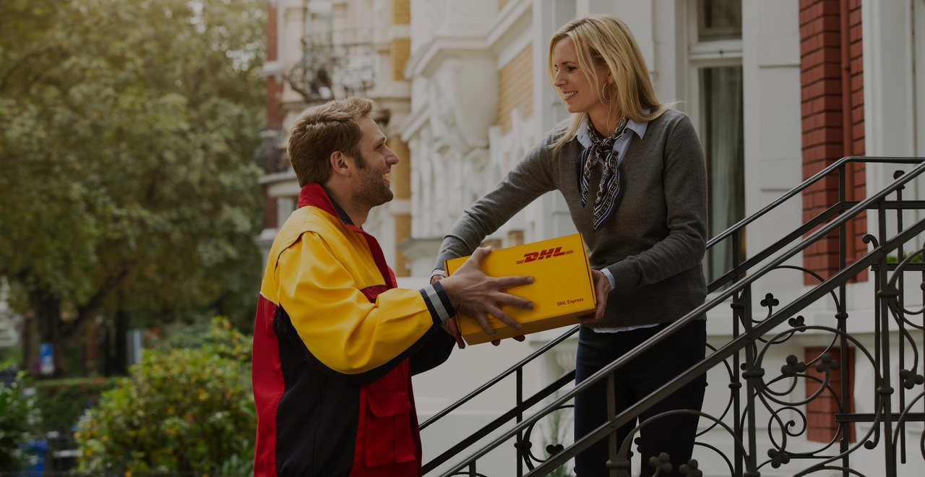

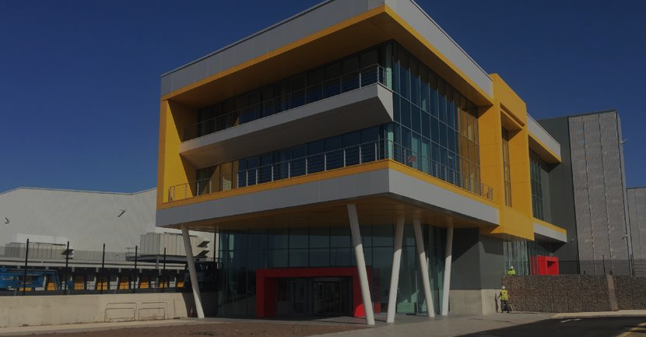

DHL Express Global Overview
220
Countries and
territories served
116,000
Employees
500+
Airports served globally
>295
Dedicated Aircraft
>2,300
Flights per day
34,000
Vehicle (PUD)
276MN
Time definite shipments annually
3 & 19
Global Hubs and Regional Hubs
3MN
Customers
127,000
Service points
3,800
Facilities
By the year 2050,
DHL Group aims to achieve
zero emissions logistics

Slide 4
Our Core Services
We offer you secure door-to-door delivery of goods and documents to and from virtually every country and territory. Whether you need your shipments delivered at the start, middle or end of a business day, our services offer full track-and-trace visibility, so you always know where your shipments are.
TIME CRITICAL
URGENT
LESS URGENT
EXPRESS9:00
EXPRESS12:00
EXPRESSWORLDWIDE
ECONOMYSELECT
Delivery before 9:00 on the next possible business day (10:30 to the US)
Delivery before 12:00 noon
on the next possible business day
Delivery by the end of the next possible working day
Delivery within a defined number of business days
Available to selected postcodes in 30 countries and territories
Suitable for individual pieces up to 25kg and shipments up to 250kg (Pallets not accepted)
Money-back guarantee
Available to selected postcodes in 73 countries and territories
Suitable for individual pieces up to 70kg and shipments up to 300kg (Pallets not accepted)
Money-back guarantee
Available to over 220
origin countries and territories
Suitable for individual pieces up to 70kg and shipments up to 3,000kg
Available within all EU member states including Turkey, Albania, Bosnia and Herzegovina and North Macedonia, Switzerland, Norway and Serbia..*
Suitable for individual pieces up to 70kg and shipments up to 1,000kg
* Not available to Cyprus and Malta
EXPORT, IMPORT, 3rd COUNTRY and DOMESTIC SERVICES
EXCL. DOMESTIC

Slide 5
DHL Core Services Domestic
Inverness
Our DHL Express Domestic service allows you to send shipments next day within the UK, including; Northern Ireland, the Isle of Man, the Highlands and the Scottish Islands.
Aberdeen
Country Office
Gateway
Hub
Service Centre
Glasgow
London Area
Basildon | Enfield | Park Royal
Croydon | Harlow | Wandsworth
Docklands | London SE | Wapping
Offshore
Guernsey | Jersey | IOM
Edinburgh
EXPRESS
DOMESTIC
EXPRESS09:00
DOMESTIC
EXPRESS12:00
DOMESTIC
Newcastle upon Tyne
 |  | Packages
Max piece wgt | 70kg | 70kg | 30kg
Max piece dims | 120x80x80cm | 120x80x80cm | 120x80x80cm
Max shipment wgt | 3,000kg | 300kg | 300kg
Delivery attempts | 2 | 2 | 2
 |  | Pallets
Max pallet wgt | 3,000kg | - | -
Max pallet dims | 300x200x160cm | - | -
Max no. of pallets | 10 | - | -
1) Individual pieces weighing more than 70 kg must be either packed in a fork-movable crate or securely loaded on to a pallet, and stackable. All shipments and pieces must meet DHL packing standards: refer to the Packing Guides on mydhl.express.dhl 2) Additional surcharges apply to any piece, including a pallet, that exceeds the scale weight of 70 kg or with a single dimension more than 120 cm. 3) A shipment is deemed unacceptable if its packaging is absent or inadequate, or if transporting the shipment would present risks of damaging equipment, other packages or injuring personnel. DHL reserves the right to either not accept or return the shipment to the Shipper. 4) These network restrictions are subject to change with 30 days' notice. | 1) Individual pieces weighing more than 70 kg must be either packed in a fork-movable crate or securely loaded on to a pallet, and stackable. All shipments and pieces must meet DHL packing standards: refer to the Packing Guides on mydhl.express.dhl 2) Additional surcharges apply to any piece, including a pallet, that exceeds the scale weight of 70 kg or with a single dimension more than 120 cm. 3) A shipment is deemed unacceptable if its packaging is absent or inadequate, or if transporting the shipment would present risks of damaging equipment, other packages or injuring personnel. DHL reserves the right to either not accept or return the shipment to the Shipper. 4) These network restrictions are subject to change with 30 days' notice.
Cookstown
Belfast
Carlisle
Teesside
Isle of Man
Leeds
Manchester
Hull
Liverpool
Sheffield
North Wales
Lincoln
Stoke on Trent
Telford
East Midlands
Birmingham
Northampton
Tewkesbury
Cambridge
Newport
Swindon
Oxford
London Area
Colchester
Transit time performance | >96% |  | Hubs and Gateways | 7
Pre-noon delivery | >67% |  | Service Centres | 43
Vehicles | +2,500 |  | Service Points | 5,000
Bristol
Reading
Maidstone
Exeter
Southampton
Gatwick
Newquay

Slide 6

DHL Core Services Globalmail
DHL Globalmail is suitable for sending a wide range of international mail items up to 2kg (4.4lbs). For pricing purposes, items are classified as one of three formats based on the size and weight.
Also, there are pricing differences, the below do not apply to DHL Globalmail:
Fuel Surcharge
Volumetric Pricing
Remote Area Service (RAS)
All formats apply when sending on priority service. Items sent on the Tracked and Plus service will be billed at the PACKED format.
LETTER
LARGE LETTER
PACKET incl. ROLLS AND TUBES
Max weight: 100g
Max Dims: 245x165x5mm
Min Dims: 140x90mm
Max weight: 500g
Max Dims: 381x305x30mm
Min Dims: 140x90mm
Max weight: 2kg
Max Dims Packets: L + W + H must not exceed 900mm. No single dimension to exceed 600mm
Max Dims Rolls and Tubes: L + (2 x diameter) must not exceed 1,040mm. L must not exceed 900mm
Min Dims: 140x90mm
What you cannot send:
Dangerous Goods - It is the customers responsibility to check if the items are accepted by the destination country. (A Material Safety Data Sheet (MSDS) can be provided to GMBSupport@deutschepost.com to check).
Prohibited and Restricted items - It is the customers responsibility to check if the items are accepted by the destination countries
(you can direct customers towards the World Customs Organisation).
Out of Scope items - Items which exceed the maximum dimensions or the 2kg weight limit cannot be forwarded via the international mail network. To avoid unnecessary delays and costs, please ensure that all items sent are within the maximum size and weight limits.
Domestic Mail - This is considered ‘ABA remail’ and is prohibited under Universal Postal Union (UPU) international mail regulations.

Slide 7
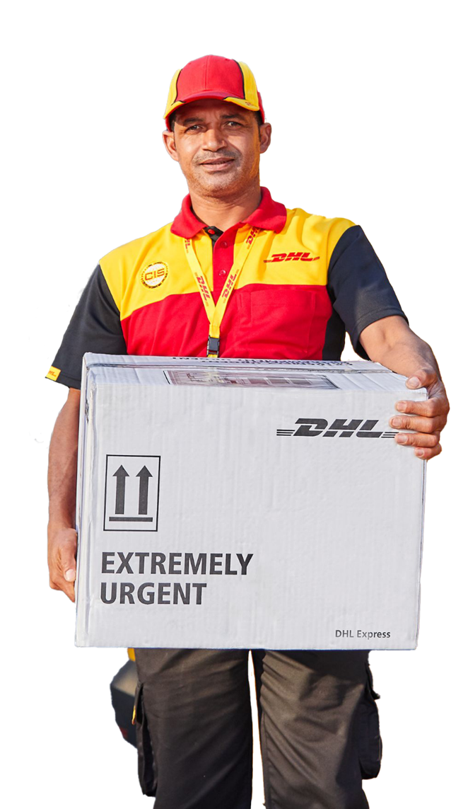
DHL Medical Express
DHL Medical Express is a premium service that combines our logistics expertise with a dedicated and unique range of features to 180 countries.
Medical Express shipments are flagged within our network with the utmost priority. Our capability provides real value to your business through speed, efficiency, safety and peace of mind for you, your sponsors, and patients. We process your shipments with extreme care and attention in the shortest time possible. We focus on what is inside the box because we understand that each shipment is there to help save lives.
Meeting short lead times for earliest delivery – Fast, flexible pickup and earliest possible delivery Monday-Saturday; short notice booking; priority handling; customs expertise
Protecting sensitive medical items – Temperature control for ambient/controlled room temperature, chilled, and frozen contents
Complying with all dangerous goods regulations – Fully compliant with local, regional, and IATA regulations; DG-compliant transportation
Providing pre-conditioned packaging and sensors – Specialist packaging for temperature-controlled hazardous/dangerous goods; dry ice; high-quality smart sensors; returns process
Ensuring full end to end shipment visibility – 24/7/365 real-time shipment monitoring; DHL Quality Control Centre (QCC); seamless information flows
Making it easy to book each shipment – via dedicated customer service team

Slide 8







NEUPC Value Proposition
Beyond Universities…Serving colleges, education authorities, agricultural colleges, and research facilities across the UK.
Fixed FSC
Rates & Surcharges
LOTS 1,2 and 3
Buyers Guide
Framework Agreement
GOGREEN+
Fixed rates of 15% TDI and 10% DOM when it comes to Fuel Surcharges.
A set pre-approved discounted tariff available to all NEUPC members which includes exemptions and no GPI Increase.
Domestic Courier Services, International Courier and Mail Services (GlobalMail), Specialist Courier Services (Sameday & Medical Express)
Summarises our product and service offerings, shipping tools and key considerations when shipping in the UK or internationally.
We hold a mutual contract with the NEUPC that is not on the standard DHL terms and conditions.
Universities and institutions can select GoGreen+ by ticking the box at checkout or you can negotiate a GoGreen contract.

Slide 9
CUSTOMS UPDATE
Presented by
Simon Roe & Daniel Johnson
DHL Express – Excellence. Simply Delivered.

Slide 10
DHL Aviation process Fast Parcel Operator
Fast Transit and clearance times Standardised processes End-to-End service
Declaration Submission
All information with any additional documentation is checked and final declaration is submitted to CDS
Customer Contact
Booking Stage
If customer contact is requested an automated email is generated to request clearance instructions
Data and image availability generates Customs Alert to start clearance process before departing from origin gateway
The DHL Express Customs declaration process starts immediately when shipment data is available
Shipment Processing
Customer Masterfile
Shipment will be released to EIDR where eligible to allow for quick release upon arrival into the UK
Importer details are used to match to Customer Masterfile record either by declarant or automation

Slide 11
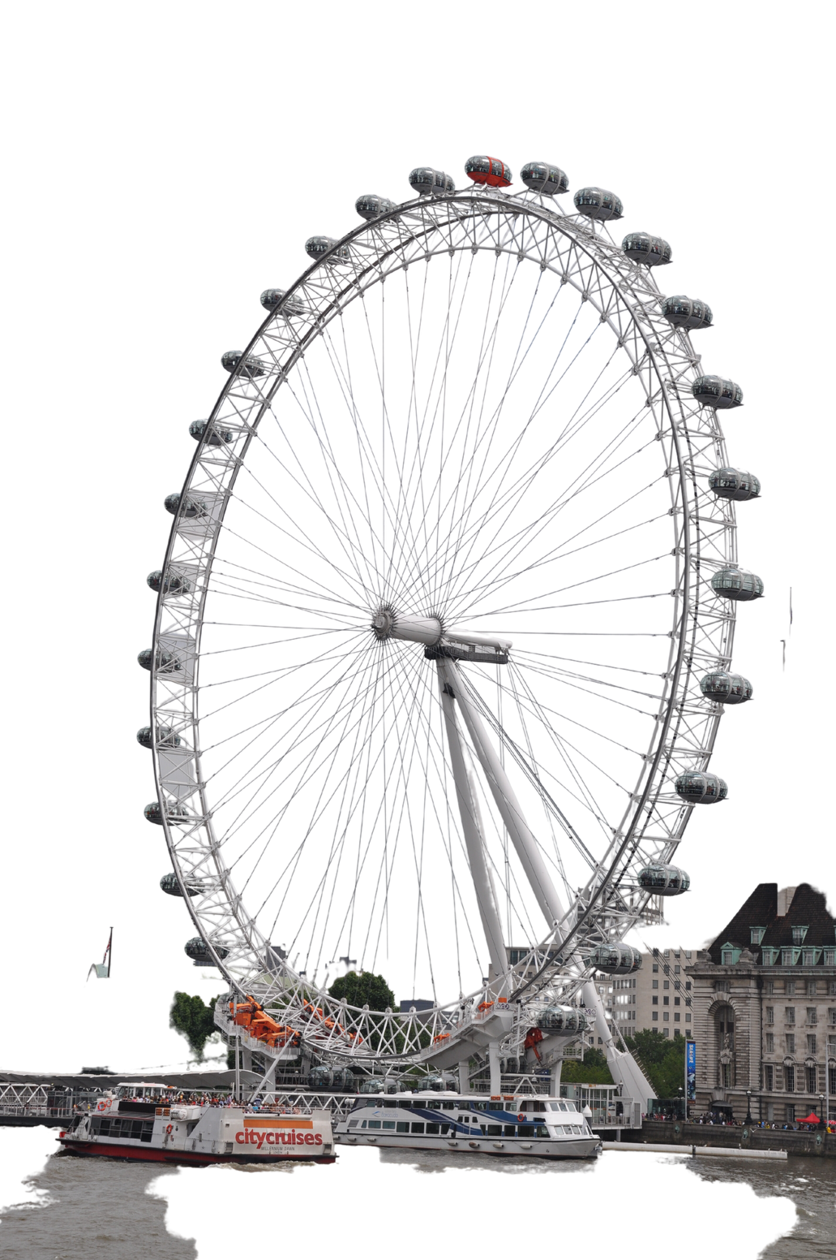
UK Imports
BIRDS and MOU
Value above £135
Value below £135
VAT is due at the point of import.
Individual customs declarations required.
Duty becomes applicable.
Shipments under the value of £135 are cleared using the Bulk Import Reduced Data (BIRDS) process.
VAT is collected at the point of sale, and not the point of import.
Cleared as a bulk declaration so shipments incur no delays.

Slide 12
Customs Overview
UK EXPORT PROCESS
Full declaration (FDE)
Supplementary declaration (SDE)
Memorandum of understanding (MOU)
Individual declaration completed
Above £10,000 and goods under customs control
Control goods = OP, ATA, carnet, cites and licensable goods
Individual declaration completed
Shipments between £900 – £10,000
Bulk declaration completed
Below £900
None controlled goods

Slide 13
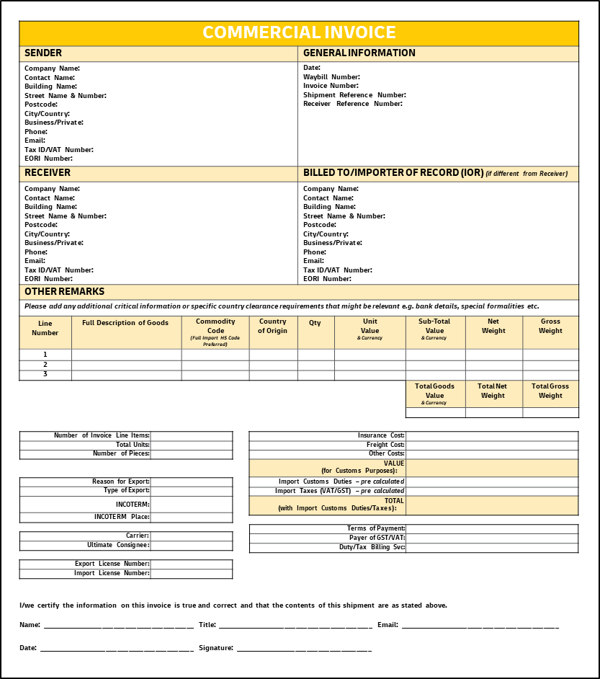
Preparing your shipment invoice
COMMERCIAL INVOICE
SENDER |  |  |  | GENERAL INFORMATION
Company Name: Contact Name: Building Name: Street Name & Number: Postcode: City/Country: Business/Private: Phone: Email: Tax ID/VAT Number: EORI Number: |  |  |  | Date: Waybill Number: Invoice Number: Shipment Reference Number: Receiver Reference Number:
RECEIVER |  |  |  | BILLED TO/IMPORTER OF RECORD (IOR) (if different from Receiver)
Company Name: Contact Name: Building Name: Street Name & Number: Postcode: City/Country: Business/Private: Phone: Email: Tax ID/VAT Number: EORI Number: |  |  |  | Company Name: Contact Name: Building Name: Street Name & Number: Postcode: City/Country: Business/Private: Phone: Email: Tax ID/VAT Number: EORI Number:
OTHER REMARKS
Please add any additional critical information or specific country clearance requirements that might be relevant e.g. bank details, special formalities etc.
Line Number | Full Description of Goods | Commodity Code (Full Import HS Code Preferred) | Country of Origin | Qty | Unit Value & Currency | Sub-Total Value & Currency | Net Weight | Gross Weight
1
2
3
 |  |  |  |  |  | Total Goods Value & Currency | Total Net Weight | Total Gross Weight
Here is an example of an invoice template with key data elements required for a successful customs clearance, which you may leverage if you provide your own Commercial / Proforma Invoice (using your own letterhead).
Additional information may be required depending on regulatory requirements, so please research the key export requirements of the origin country, import requirements of the destination country, and / or request regulatory advisory from Tax / Legal advisors.
In addition to providing the invoice electronic soft copy (e.g. PDF file), you must also provide the complete and accurate electronic invoice data to DHL. This avoids manual data entry (from the PDF file to Customs Systems), resulting in an efficient and high-quality Customs Clearance process for your shipments.
Number of Invoice Line Items:
Total Units:
Number of Pieces:
Insurance Cost:
Freight Cost:
Other Costs:
VALUE (for Customs Purposes):
Import Customs Duties – pre calculated
Import Taxes (VAT/GST) – pre calculated
TOTAL (with Import Customs Duties/Taxes):
Reason for Export:
Type of Export:
INCOTERM:
INCOTERM Place:
Carrier:
Ultimate Consignee:
Terms of Payment:
Payer of GST/VAT:
Duty/Tax Billing Svc:
Export License Number:
Import License Number:
I/we certify the information on this invoice is true and correct and that the contents of this shipment are as stated above.
Name: ________________________________________ Title: _________________________________________ Email: __________________________________________ Date: _________________________________________ Signature: ____________________________________

Slide 14
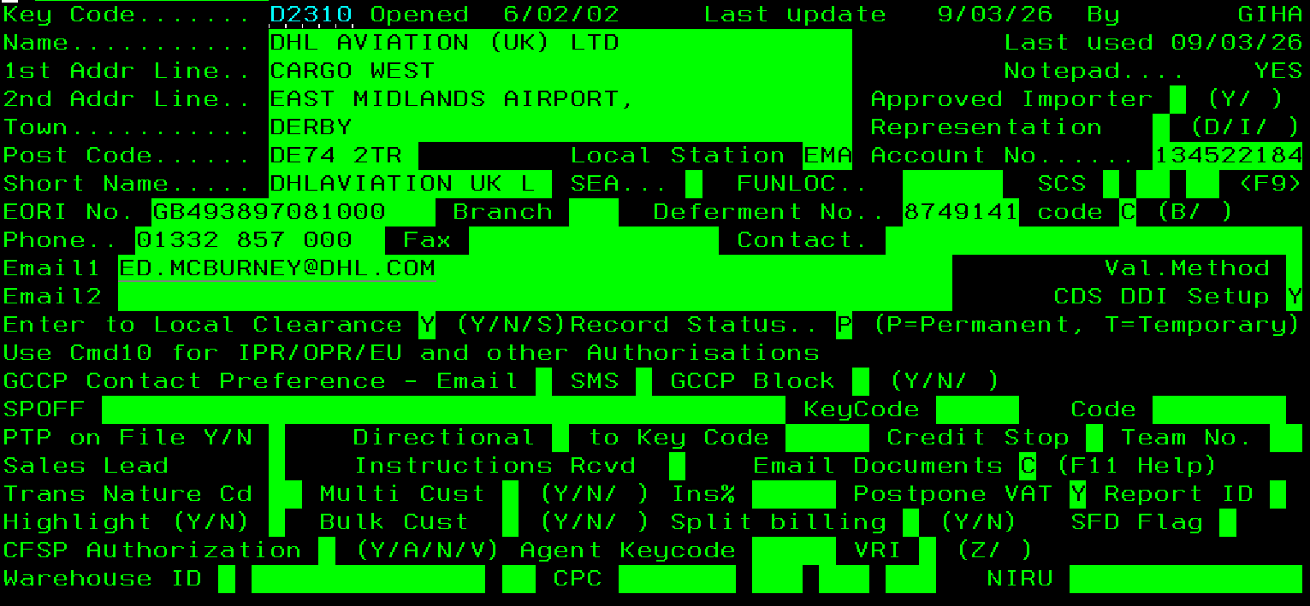
Customer Master File (CMF)

Slide 15
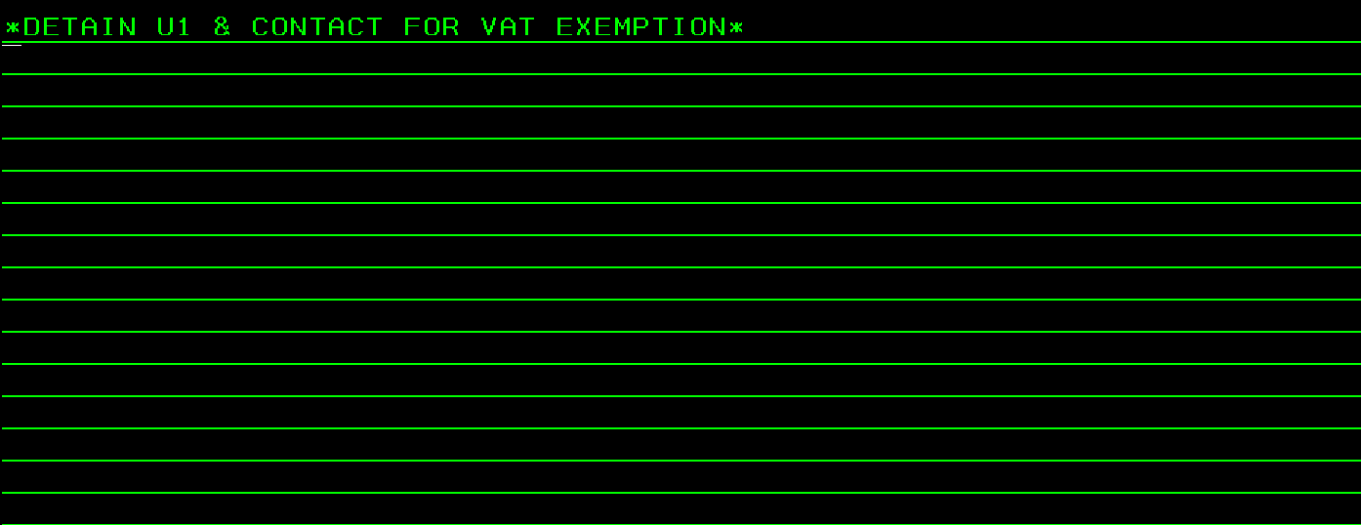
CMF Notepad

Slide 16
Inward and outward processing
Inward Processing
Temporary imports to be recalibrated, repaired or repackaged have been restricted to 10 shipments in a rolling year unless the UK importer holds an IP authorisation.
The inbound AWB and invoice must clearly indicate goods are temporary for repair to ensure the correct declaration to customs is completed.
No IP number: Importer is limited to 10 shipments in a rolling year, VAT and duty is payable on import, however the customer can reclaim this once the goods are re-exported. Goods must be re-exported within 6 months unless NIRU grant an extension.
IP number: No limit to the number of entries, VAT and duty is not charged by HMRC at the point of import. Goods must be re-exported within 6 months; however, the customer may have agreed an extended time with NIRU.
When goods are re-exported a pre-alert email must be sent to ukexportprealert@dhl.com on the day of shipments pick up to ensure the correct export entry is completed, quoting the AWB in the subject box, the type of entry required and the original import AWB/entry number within the body of the email. Please state if warranty or non-warranty repair has taken place and in addition if the latter the repair charge.
The customer will need the evidence of export in order to reclaim any VAT/duty applied on import and/or to prove to HMRC the goods have been re-exported correctly via the BOD (Bill Of Discharge). Additional information and support can be found via the HMRC GOV.UK website below:
https://www.gov.uk/guidance/using-inward-processing-to-process-or-repair-your-goods
Outward Processing
Temporary exports to be recalibrated, repaired.
Customers that do not hold an OP (Outward Processing) authorisation will be restricted to 10 shipments in a rolling year when using Authorisation by Declaration. If they hold OP authorisation there is no limit using this process.
On export from the UK, the customer must send a pre-alert email on the day of shipment pick up to our export team ukexportprealert@dhl.com, please ensure the AWB is quoted in the subject box, and the type of entry required within the body of the email including any authorisation numbers. We would also require a serial number/s or reference number/s relating to the goods in order for the goods to be clearly identified on export and then re-import.
When repaired shipments are being returned to the UK, the shipper must clearly mark the shipment paperwork as ‘Return after Repair’, also if a ‘warranty or non-warranty repair’. If non-warranty the cost of repair will need to be quoted separately on the invoice, revenue will be calculated on the repair costs. Provide the original export AWB if available.
We would need to ensure we hold CMFs both for import and export for the customer, plus any additional information to support prompt and accurate clearance, i.e. EORI, IP/OP authorisation numbers if held, any standing instructions, NLR (No License Required) etc. Additional information and support can be found via the HMRC GOV.UK website below:
https://www.gov.uk/guidance/using-outward-processing-to-process-or-repair-your-goods

Slide 17





UK Customs contacts
Amendment requests
Imports – ukinvoicequeries@dhl.com
This mailbox in only monitored, Mon-Fr 09:00 – 17:30
Where an invoice has been raised which the customer wishes to dispute/amend. Amendment requests on DHL’s Deferment Number (GB-8151025 or NI-6248331)
Imports – ukavipostclr@dhl.com
Actions all amendment requests on the customers Deferment number or nil revenue, not on DHL’s DAN.
Export – ukc81@dhl.com
Actions all amendment requests for incorrect export entries
Import and Exports – ukpcaescalations@dhl.com
(SLA 1 working day) This email will be monitored by the PCA Specialist for urgent amendment escalations.
UK Customs Enquires
UK Export Queries
UK Import Queries
Telephone Support
UK Post Entry Queries

Slide 18
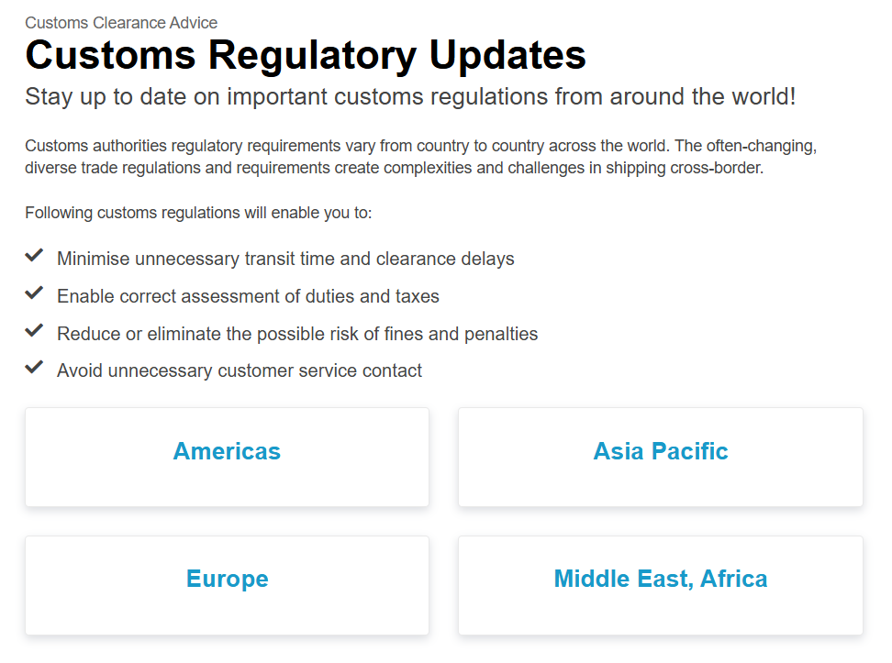
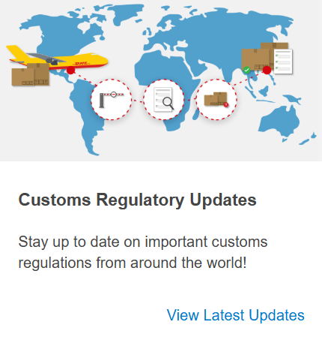
Regulatory Customs updates and guidelines

Slide 19
DHL MyGTS (Global Trade Services)
DHL MyGTS is a free online tool providing the essential Customs Information you need to plan, budget and understand international shipping requirements globally.
Our online services are intuitive and easy-to-use, offering quality up to date global trade information. Including guidance regarding:
Interactive Tariff Code Classification
Estimated Landed Cost Calculation
Import and Export Customs Requirements
Trade Documentation
Access the full range of DHL MyGTS via the free browser based solution, accessible from any computer. Just register as a new user, create your username and password and you are on your way.

Slide 20
NEUPC
SPECIAL SERVICES GROUP
Presented by Luke Rennocks
and guest presenters: Simon Roe, Daniel Johnson and Jake Dodds
DHL Express – Excellence. Simply Delivered.

Slide 21

Tailored solutions to your needs making the impossible, possible.
Agenda
Special Services Overview
Sprintline
Jetline
NEUPC Support
07483 526 202
Modern logistics is more than transporting shipments from A to B. Today's fast-moving environment requires organisations to be extremely flexible in order to react to the demands of the market. As your partner, we put speed, security and individuality first.
For years we have been supporting Universities from all over the world around the clock as a competent partner with extensive experience, local know how and well-founded customs expertise. Thanks to our experts, they not only benefit from flexible transport options, but also from services that are tailored to their needs
jake.dodds2@dhl.com
Jake Dodds
Business Development Manager
Special Services

Slide 22








Special Services Group
OUR SPECIAL SERVICES GROUP
Your emergency needs understood
Whether you're shipping urgent documents, medical supplies, corporate gifts or spare parts, we offer Same Day delivery by road or air via our trusted network of specialist service providers.
NEXT FLIGHT OUT
ON-BOARD COURIER
DEDICATED VEHICLE
The benefits:
Safeguard your reputation
Deliver your urgent items on time and in full.
Maximise your choice
Ship items that cannot be transported through our express network.
Minimise your financial losses
Reduce the financial impact
relevant to your industry.
HEAVY WEIGHT
DANGEROUS GOODS
TO BOOK A SPECIAL SERVICE
Contact our Special Services Group on specialservices.gb@dhl.com or call 0844 248 0505
Operational Hours: Mon - Fri 08:00 – 18:00 & Sat - Sun 08:00 - 14:00

Slide 23

Special Services Sprintline
The Direct Way, SPRINTLINE
Do you want full control and visibility over your shipments?
Our sprintline service will transport your shipment exclusively. From a small package to a full truck, anything is possible. Our courier will pick up your shipment and immediately drive it to the destination.
We offer individual handling that responds to the special situation. Whether dangerous or bulky goods we find the right individual solution for your consignment. Thanks to high security precautions and a specialised network, even your most valuable goods are in the best hands with us.
Door to door direct by dedicated vehicle
Domestic and European coverage
Collection and delivery out of hours
Delivery to an individual (ID Check)
White glove delivery options
Temperature controlled options
Dangerous goods options

Slide 24

Special Services Jetline
Global coverage
If tomorrow is too late, we are your saviour in times of need.
Our aim is to keep the wheels of your business turning. To achieve this, we transport your critical shipment on the next available flight, accompany your shipment from collection to delivery, or even charter a plane. Covering more than 220 countries and territories across the globe, Same Day Jetline offers a fully flexible door to door export, import, and domestic service.
This ensures an ideal balance between speed and security, while maintaining full transparency throughout your shipments journey.
Our Logistics Control Tower monitors every step of the transportation; from the pickup confirmation to the current traffic situation, the loading of the shipment by the airline, or the flight time.
On board courier personal carry-on option
1st and last mile by dedicated vehicle
Next flight out
Customs formalities
Dangerous goods solutions
Solutions for emergencies

Slide 25

Supporting Universities with
DHL Express Special Services
NEUPC Specific Support
Universities often require specialised logistics beyond standard carrier networks. DHL Express Special Services can support when shipments are oversized, overweight, high-value, or require white-glove handling.
Key University Logistics Needs:
Transport of sensitive lab equipment and research materials
Temperature-controlled or secure handling for biological samples and chemicals
Movement of high-value scientific instruments
Time-critical deliveries for experiments, conferences, and academic collaborations
Campus or inter-campus equipment relocations
How DHL Express Special Services Helps:
Dedicated vehicles for direct, same-day transport
White-glove handling for delicate or high-value equipment
Oversized and overweight shipment solutions
Secure chain-of-custody for sensitive research items
Customised logistics when the standard Express network cannot accommodate the shipment (brokerage, IOR, temp exp / imp support)

Slide 26
THANK YOU

Slide 27
Contact Us
Luke Rennocks
Key Account Manager
luke.rennocks@dhl.com
Sahyeeda Saleem
Assistant Category Manager
s.saleem@neupc.ac.uk

