Slide 1

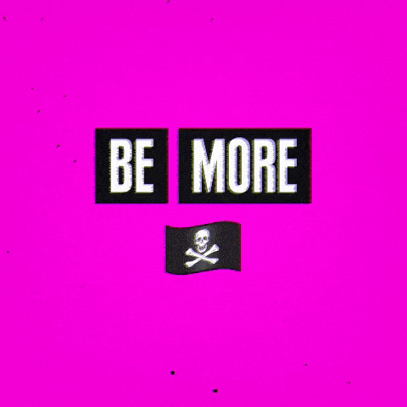

Slide 2
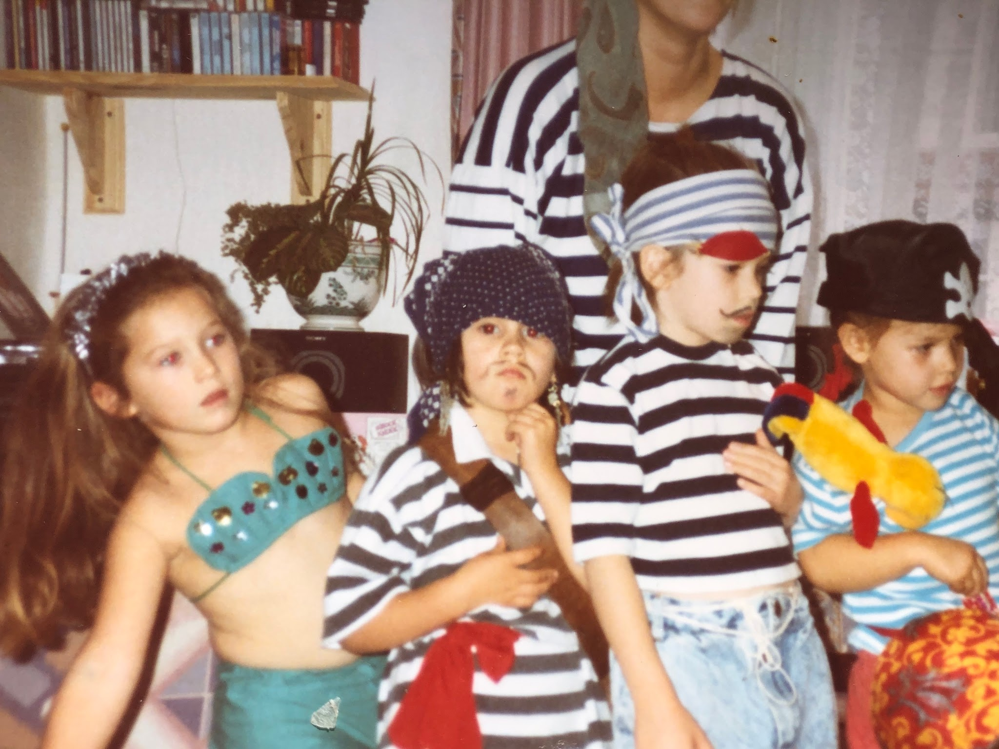

Slide 3


WHAT WAS
THE LAST RULE
YOU BROKE?
Notes:
(and what was it?) The purpose of this questions is get everyone to think about what they consider ‘a rule’
Most of the time when people think of a rule their mind leaps to breaking explicit rules such as speeding, or maybe disobeying a policy
But the work with BMP is less about the explicit rules and more about surfacing the implicit rules - the unspoken rules, norms and assumptions that govern what we think is possible (or not). The rules like this is what you can and can’t say etc.
But we can’t change what we don’t name or define!
We’ll come back to rule breaking later

Slide 4

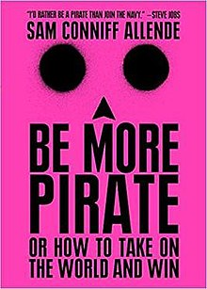


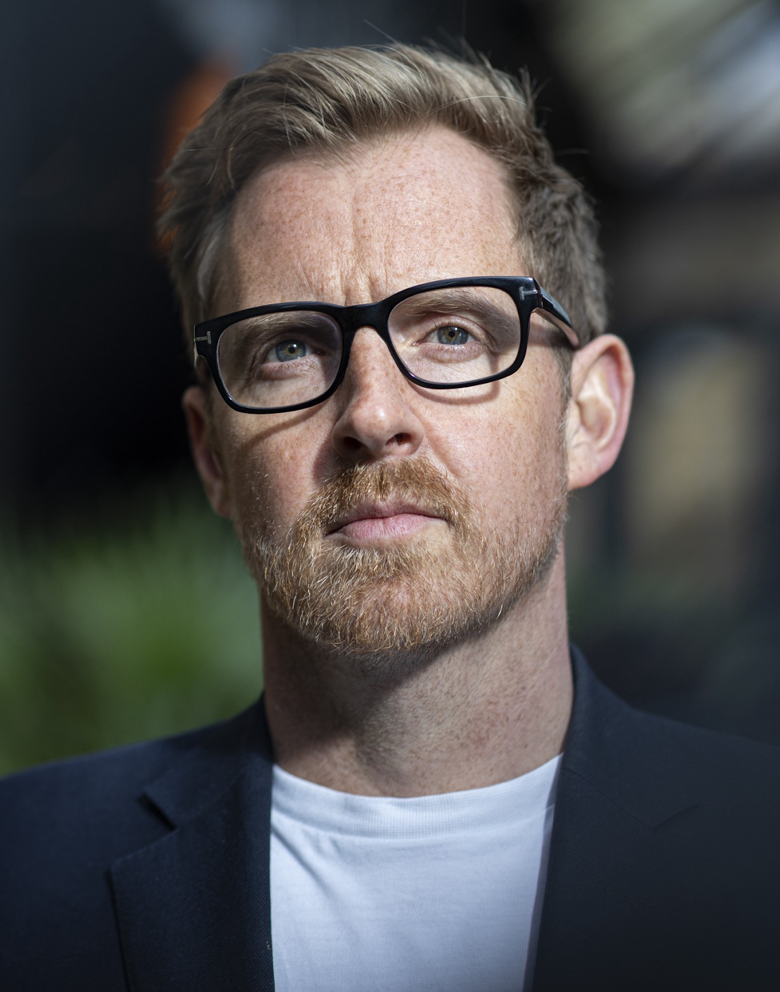
Notes:
Ahoy

Slide 5
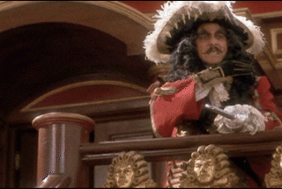

Notes:
Unfortunately…this is how we tend to think about pirates
Cartoonish rogues (or lying thieving sociopaths) who are only out for themselves.
Not quite true…
That’s the story Disney, and the establishment told us

Slide 6
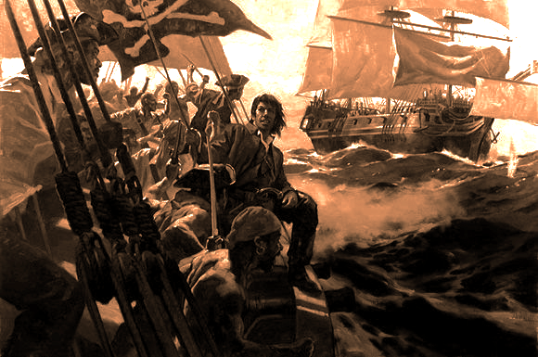
THE GOLDEN AGE OF PIRACY
1695-1725 (ROUGHLY)

Slide 7
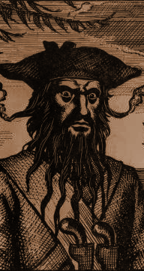
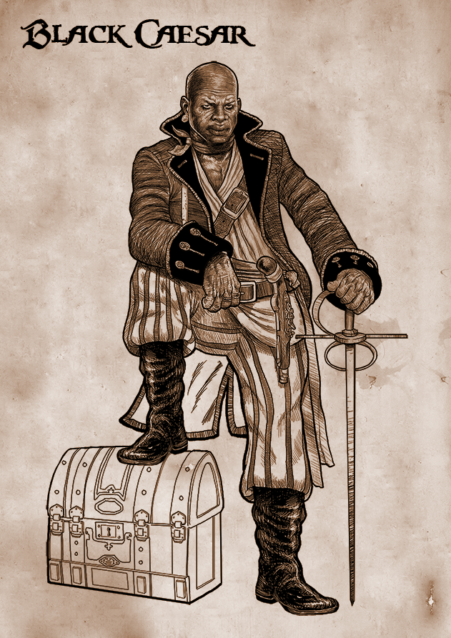
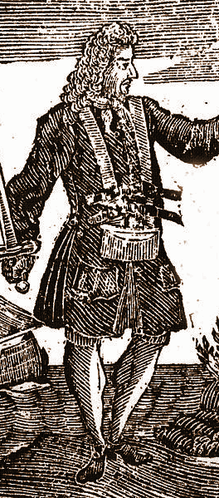
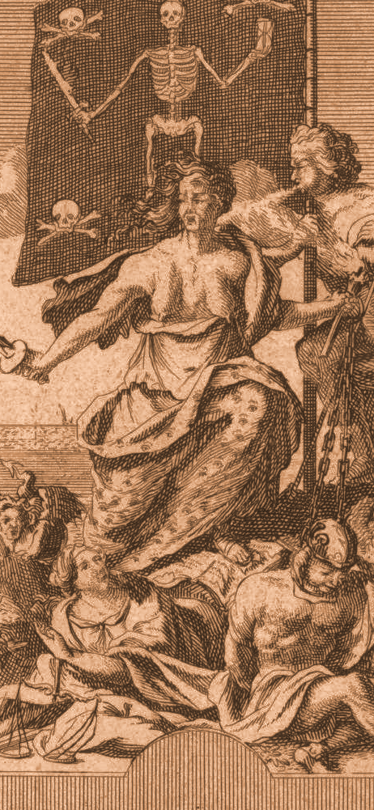
DIVERSITY & INCLUSION
Vs EXPLOITATION AND IGNORANCE
Notes:
On a pirate ship you saw real diversity
Female pirates! (Anne bonny on the far right)
Black pirates! In the laltter half of the golden age of piracy, pirates regularly freed slaved ships
Pirates werea actually a diverse bunch from all kinds of socio-economic backgrounds.

Slide 8
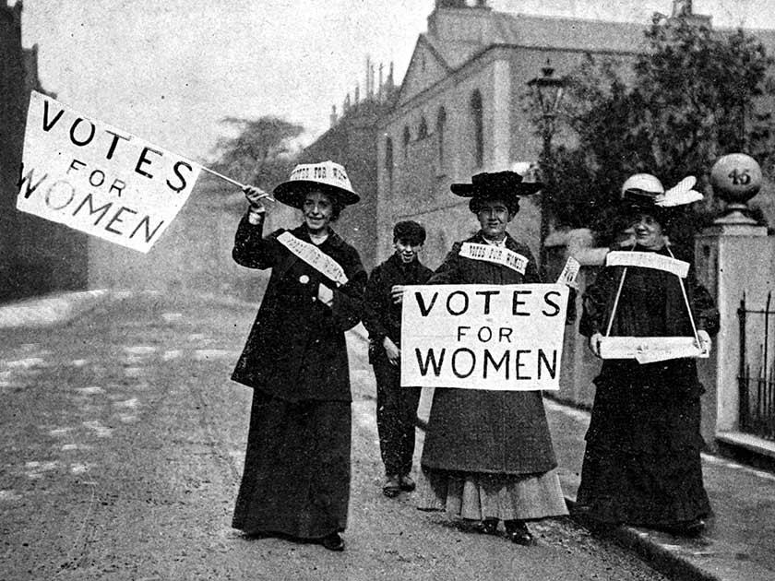
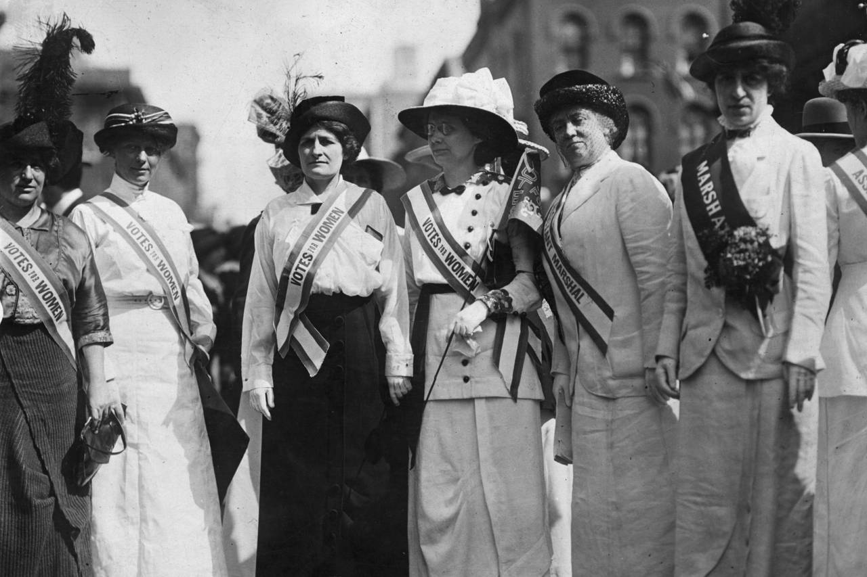
A VOTE FOR ALL
Vs. ONLY THE WHITE GUYS
Notes:
Pirate crews were democratic! More democratic than ancient greece where only men had the vote.
They had a one person one vote system for all decisions making (except in battle where the captain had final say)

Slide 9
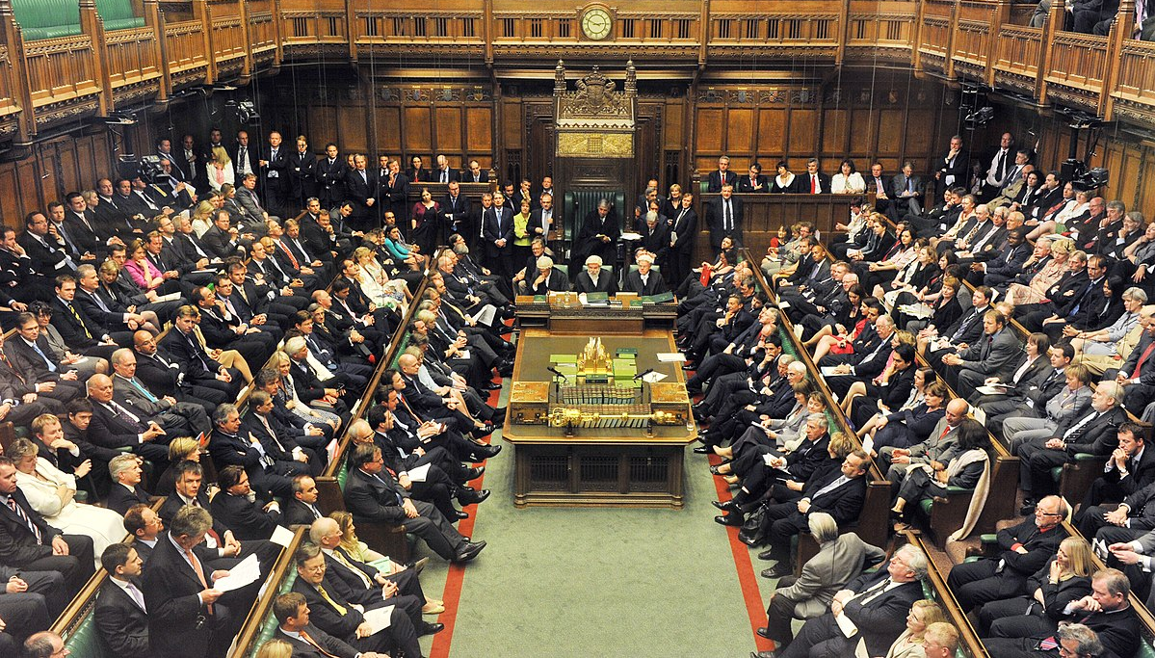
DUAL GOVERNANCE
Vs. AUTOCRATIC OUT OF TOUCH RUTHLESSNESS
Notes:
They put proper checks and balances on power. Leadership operated under a dual governance system (parliament followed suit because it was so effective) - captain and quartermaster were equal leaders. Captain led the strategy, the quartermaster looked after the crew (especially doling out punishment and money). They made sure the captain couldn’t become a tyrant .
AND, leadership roles could be voted in and out by the crew. You were never a leader for life. It was the opposite of dictatorship.

Slide 10
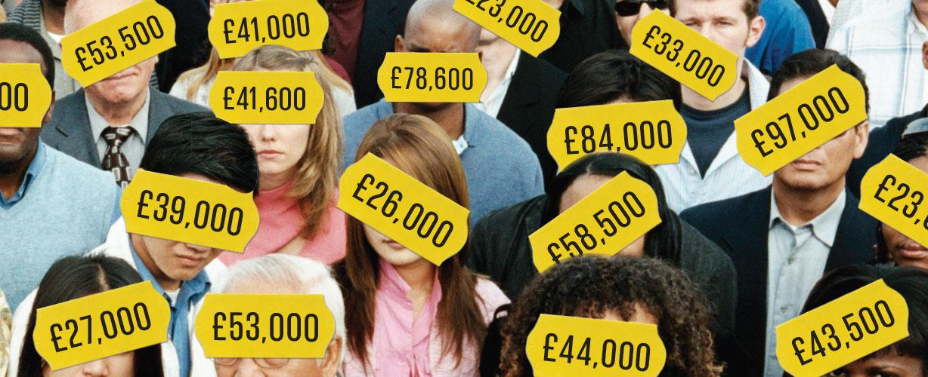
EQUAL & TRANSPARENT PAY
Vs. HUGE PAY INEQUALITY
Notes:
They had a system of fair and equal pay system.
Leadership roles would typically get 2-4 x more than the average crew member (much better than what we typically see today)
Also - this was mainly a strategic, rather than a moral move (I suspect) because they were trying to avoid mutiny!

Slide 11
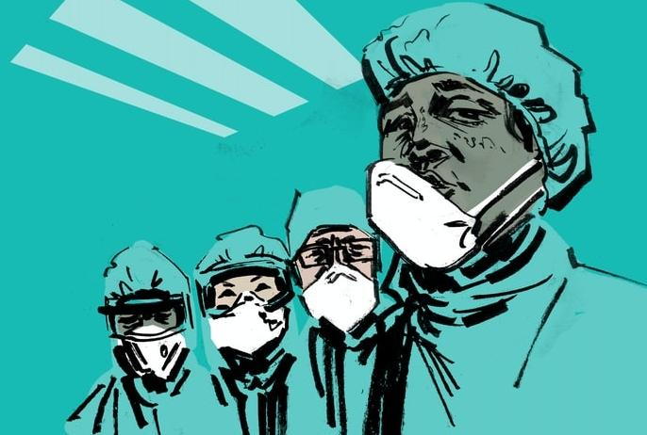
PROTECTION FOR ALL
Vs BEING LEFT FOR DEAD
Notes:
Pirates enacted an early form of health insurance by giving money to anyone who received an injury in battle.
Again, strategic - they wanted to incentive everyone to take part - but I imagine it also made them feel looked after and valued.

Slide 12
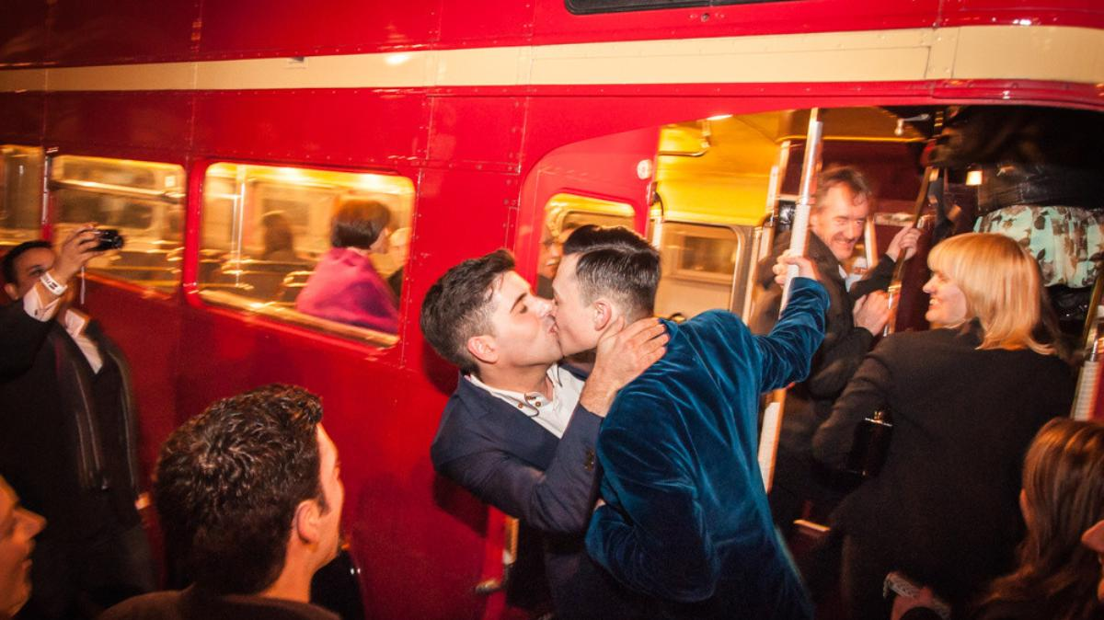
SAME SEX MARRIAGE
Vs THE LASH OR EXECUTION
Notes:
Yes, even same sex marriage! There was a documented ceremony for same sex relationships that was so sophisticated it had an inheritance clause so if one of the partners due, the other would inherit their wealth.
Some historians debate whether sometimes the marriages were just friendships, designed to pass on wealth, but homosexuality was also definitely well documented in pirate life.

Slide 13
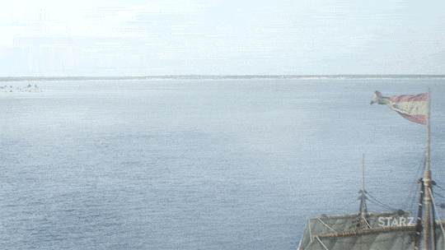
NETWORKED AND AGILE
Vs COMMAND AND CONTROL
Notes:
Pirate were also highly collaborative. They didn’t even fight with each other, but worked together if they needed to take down navy vessel.
They were dynamic, agile and well networked - fighting common enemies whilst retaining their individual crew independence.

Slide 14
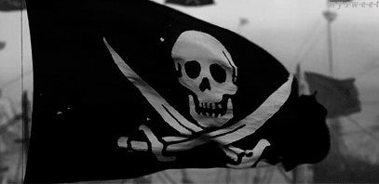
Vs BLAND AND PREDICTABLE
WEAPONISED STORYTELLING
Notes:
All crews were distinguished by a version of the jolly roger -arguably the world’s most enduring viral brand
This again was highly strategic. THey did not want to waste resources in battle so would deliberately weapsonise their story so that they drove fear into the heart of enemies, ensuring that anyone who saw the skull and crossbones on the horizon would immediately surrender.
This mean that, by frequency at least, pirates were probably the least violent of all.

Slide 15
PIRATES VS REBELS
Notes:
All crews were distinguished by a version of the jolly roger -arguably the world’s most enduring viral brand
This again was highly strategic. THey did not want to waste resources in battle so would deliberately weapsonise their story so that they drove fear into the heart of enemies, ensuring that anyone who saw the skull and crossbones on the horizon would immediately surrender.
This mean that, by frequency at least, pirates were probably the least violent of all.

Slide 16
Notes:
So all of that history is captured in Be More Pirate.
What happened next is that individuals and companies started writing to Sam to either explain that they were using the book to take action, or asking us to help them.
Many of those stories became part of the second book - How to Be More Pirate. This was really a bid to understand how you take the inspiring story of th pirates and make it work in the 21st century

Slide 17
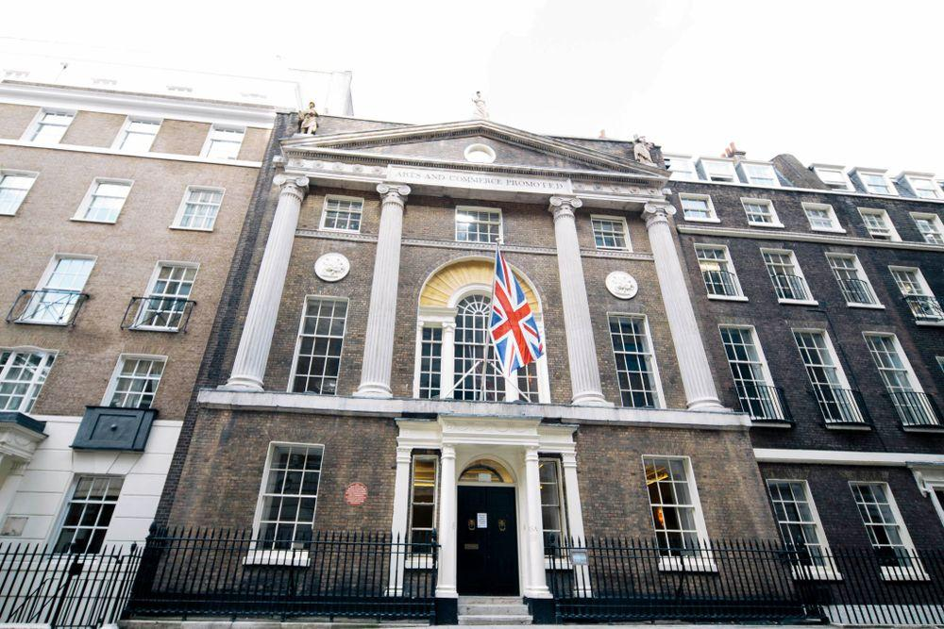


Slide 18
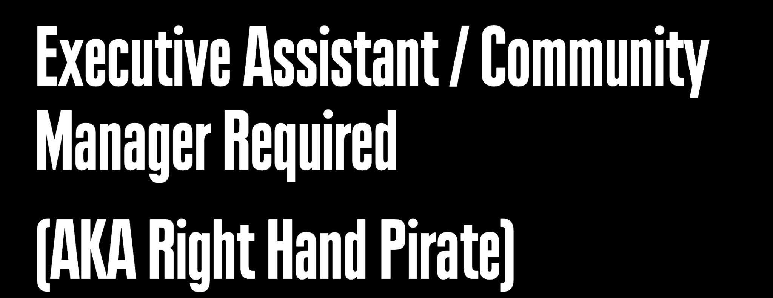
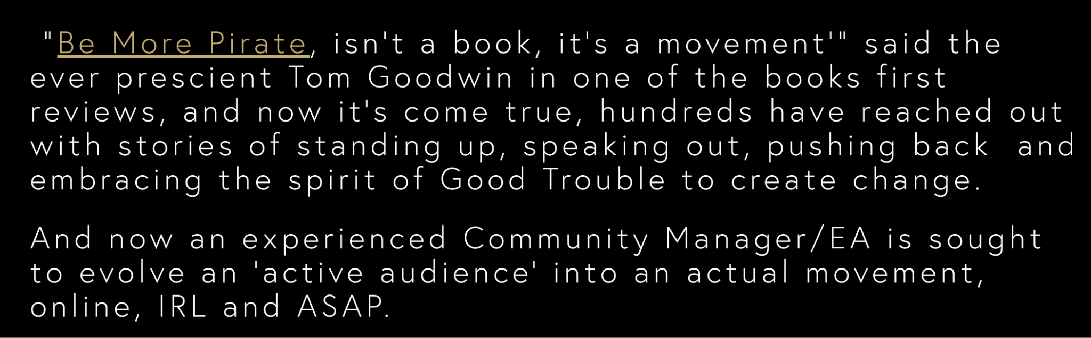
Notes:
Right hand pirate

Slide 19
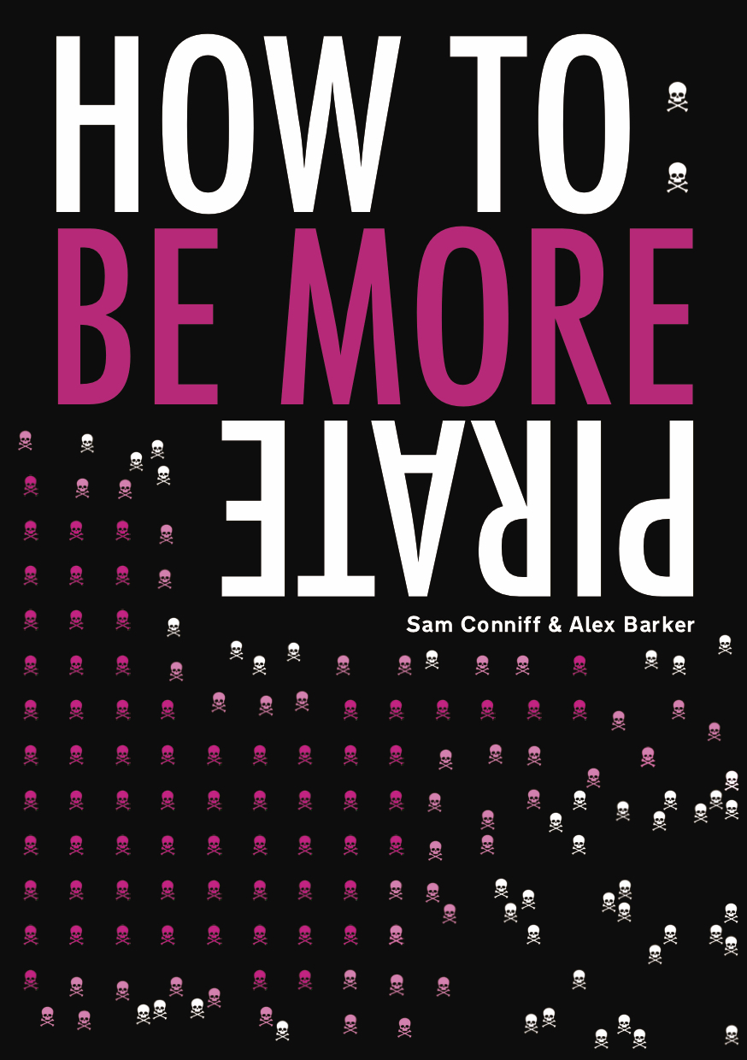
Notes:
So all of that history is captured in Be More Pirate.
What happened next is that individuals and companies started writing to Sam to either explain that they were using the book to take action, or asking us to help them.
Many of those stories became part of the second book - How to Be More Pirate. This was really a bid to understand how you take the inspiring story of th pirates and make it work in the 21st century

Slide 20
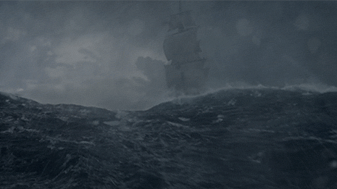
NO ONE
IS COMING
TO SAVE YOU

Slide 21
KNOW WHAT YOU
STAND FOR
Notes:
Can pause for a question here to see if people can name what they stand for.

Slide 22

MAKE IT FUN
KILL ALL METAWORK
START BEFORE YOU’RE READY
GET COMFORTABLE BEING UNCOMFORTABLE

Slide 23
REBELLION CAN BE A
RESPONSIBLE CHOICE
Notes:
Can pause for a question here to see if people can name what they stand for.

Slide 24

PROF. DR ANDREW SHARMAN
“Too many complicated rules actually make us less safe. Safety is about vigilance and good judgement.”

Slide 25
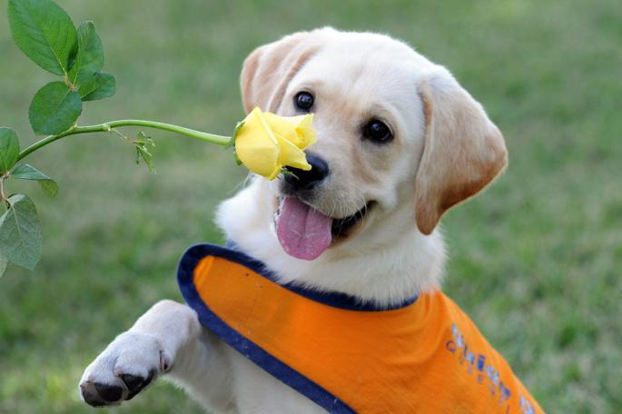
INTELLIGENT
DISOBEDIENCE
Notes:
If you want to look at rule breaking in more depth - there’s a term called intelligent disobedience which comes from guide dog training. First you train the dog to be obedient - to take instructions from the human,then it has to go through a period of disobedience training, when it learns to listen to it own instincts and judgment, to know when to disobey the human
Humans in general get no such training - were actually conditioned largely to uniformly obey figures of authority, through fear, (from school). For the majority of people its very difficult to confidently challenge leaders or break rank with the group
(all in a book called Intelligent Disobedience by Ira Shalleff)

Slide 26
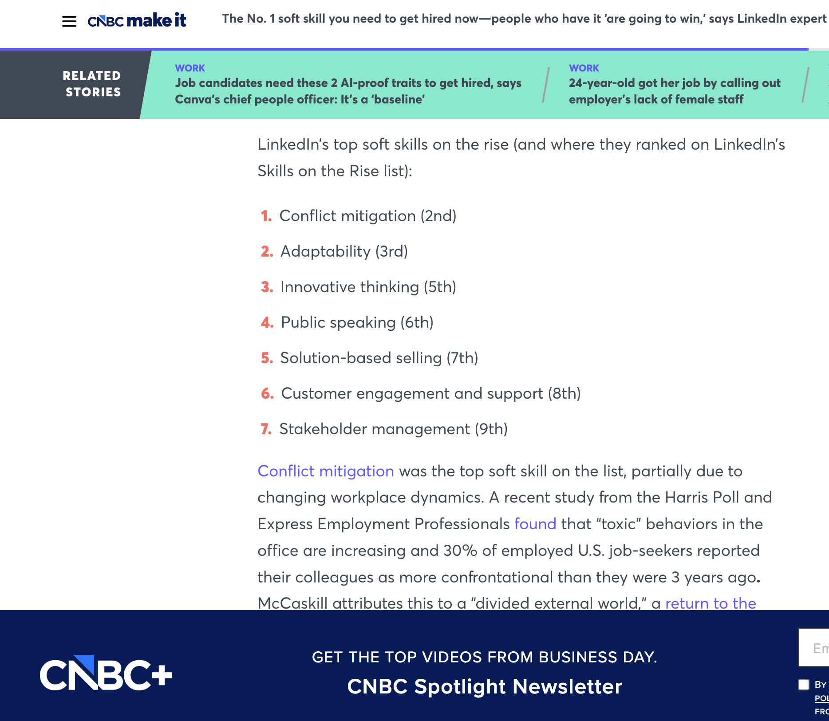
COMPANIES
WANT CREATIVITY…
BUT REWARD CONFORMITY

Slide 27
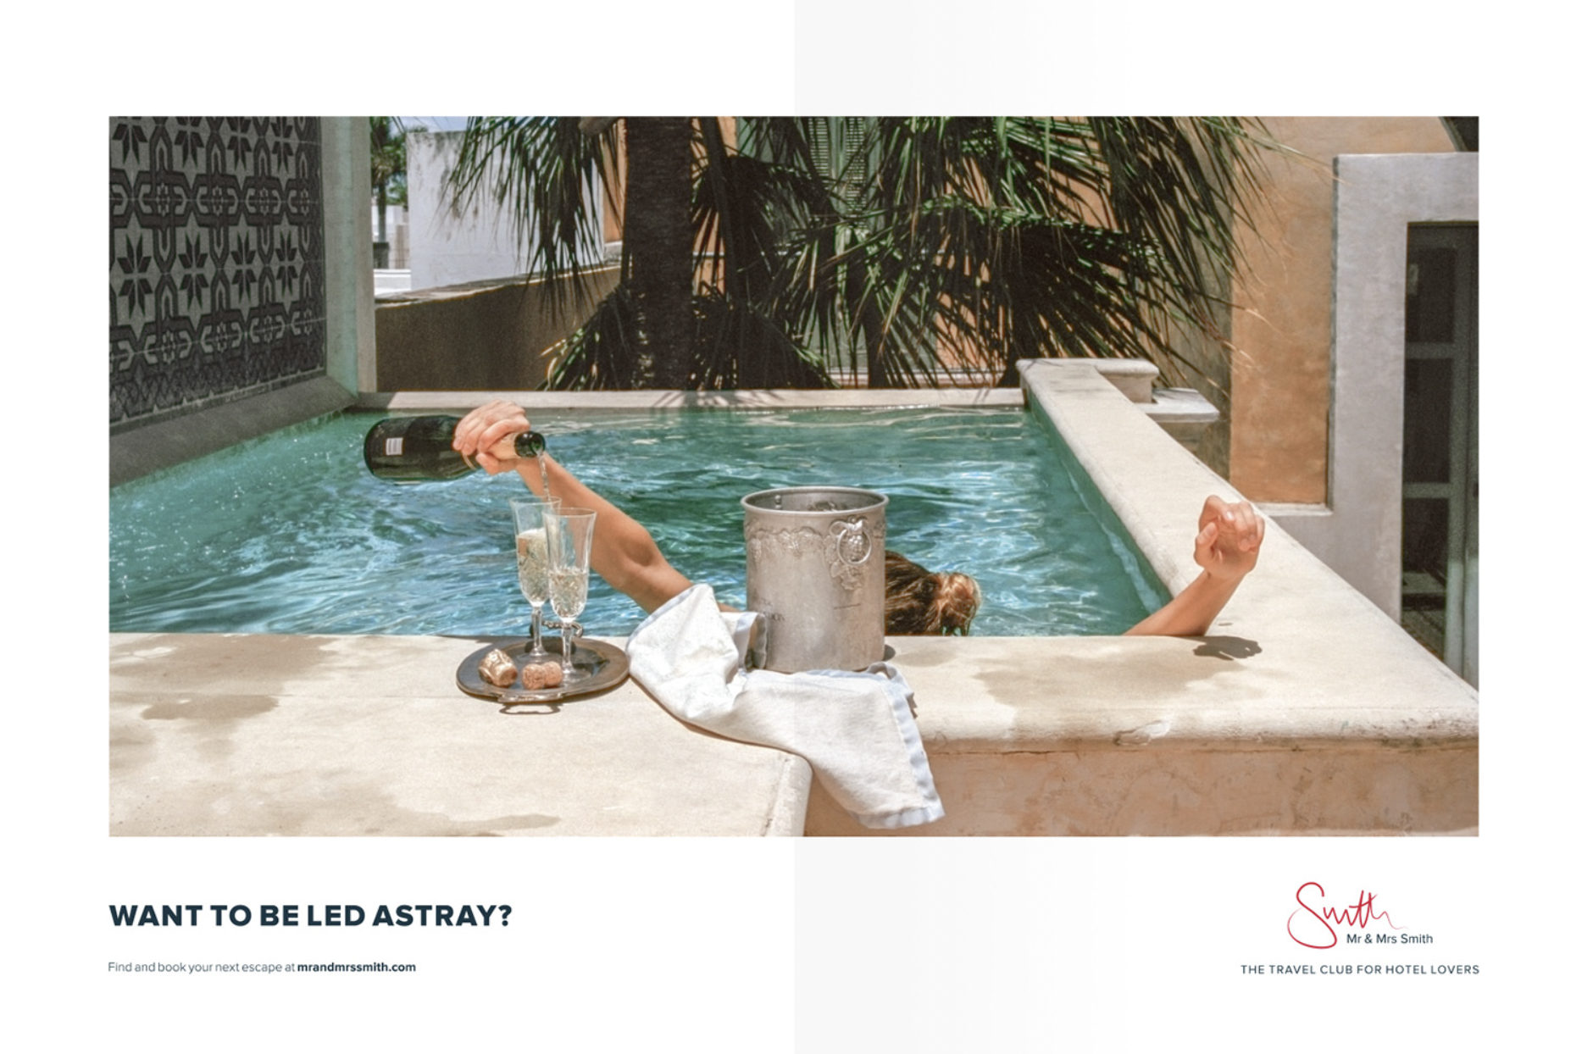
SO REWARD THE OPPOSITE…

Slide 28
ASK
uNComForTAbLe
QUESTIONS
Notes:
Can pause for a question here to see if people can name what they stand for.

Slide 29
Why don’t we talk about what happens when people leave? What is the team’s biggest weakness? How much should we pay each other? What happens when female employees have two consecutive pregnancies? Does our boss earn too much - how much is too much? How can we bring our whole self to work and still have boundaries? Who is doing work that has zero impact? Will we still care about the NHS after Covid? Should our organisation really exist - what are we contributing to the world? When it comes to money, how much is enough? What does an organisation look like when there are no more difficult questions to ask?
Notes:
Here are some examples of uncomfortable questions I have collected

Slide 30

IN THE DARKNESS
THERE IS DISCOVERY,
THERE IS POSSIBILITY,
THERE IS FREEDOM

Slide 31

WHAT?
WHO?
WHERE?

Slide 32
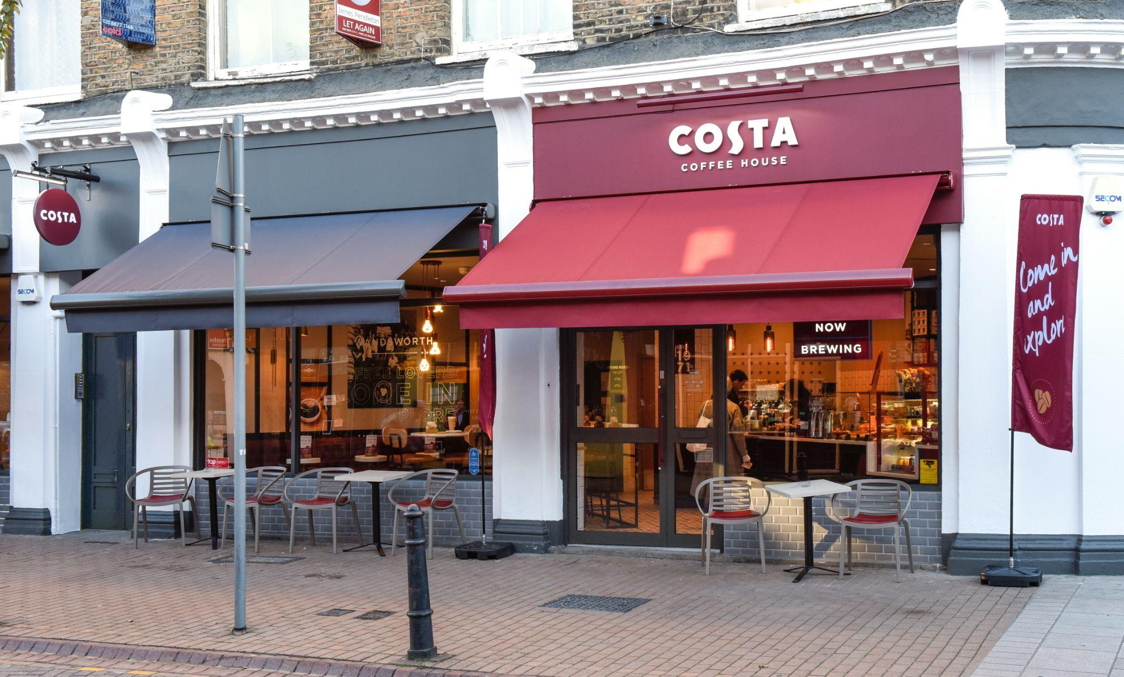
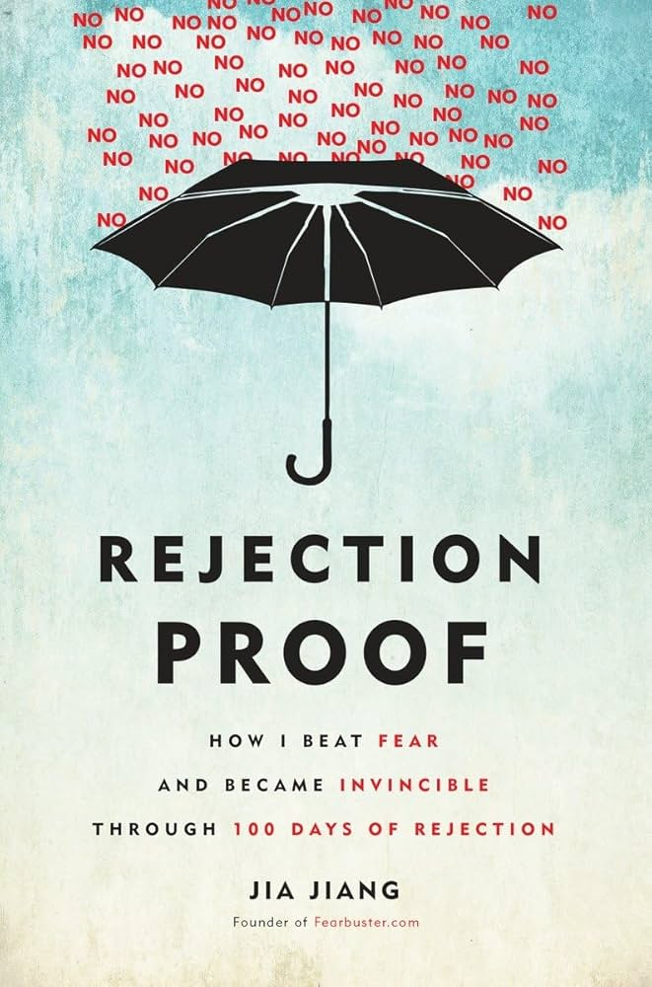
Costa coffee photo

Slide 33
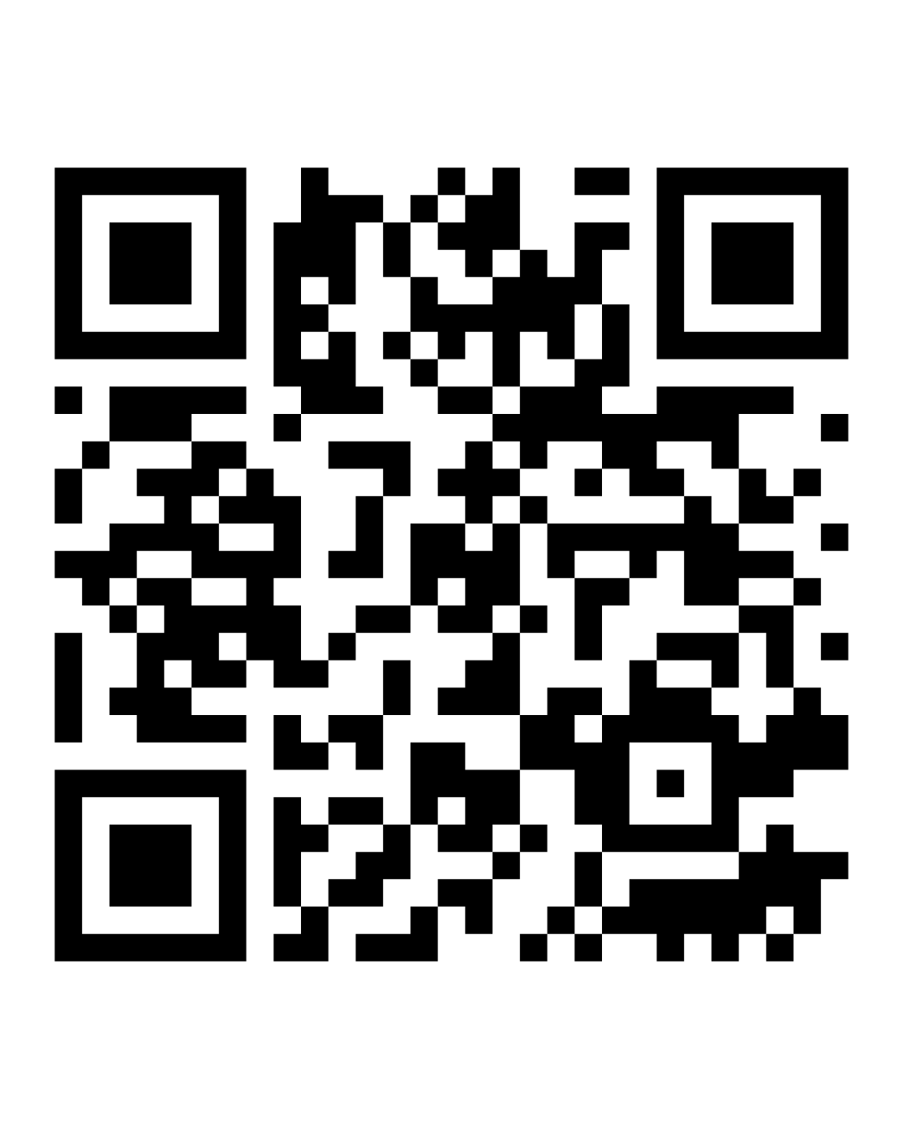
GO OFF THE
EDGES

Slide 34
BAD RULES ARE MADE…
WHEN THEY’RE MADE WITHOUT
THE PEOPLE THEY’RE FOR.
Notes:
Now it’s up to you

Slide 35
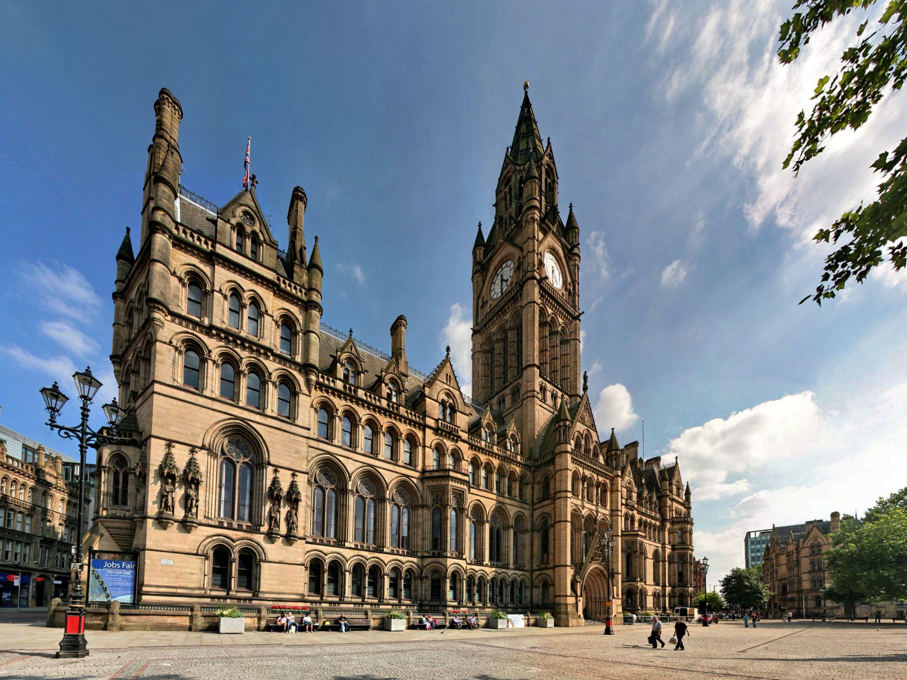
BRING THE SOUL BACK TO WORK

Slide 36
#BEMOREPIRATE BREAKING THE TYRANNY OF EMAILS BY:
Thinking before I email - can I have a conversation instead?
Taking protected time away from email to focus on the stuff that makes the biggest difference
Checking my tone - am I structuring it in a way I’d be pleased to receive?
If it’s bad news I won’t deliver it by email
Notes:
Another team in a big local authority created a code together, and one of the articles was to ‘Bring the Soul back to work’
To make this feel real, they decided to tackle email culture and created 4 new rules for it.
But the important thing is that they made it their email signature - so everytime you sent an email you saw the new rules.
If you can make the small bold action repeatable, even better as it will stand a much better change of staying.

Slide 37
RULES ARE CREATED
OR BROKEN, SOCIALLY
Notes:
Now it’s up to you

Slide 38
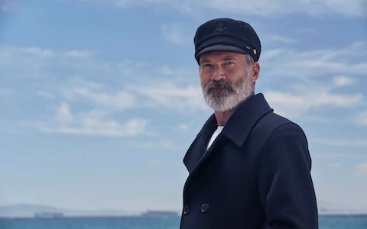

BE HERE NOW
MEETING FREE MONDAYS
F**K IT TIME
CLEAR THE DECKS
Notes:
The team at Birdeye created numerous small bold steps that they could enact together in smaller teams.
One was ‘be here now’ - which simply meant no mobile phones in meeting. No one was allowed to do two things at once anymore.
Pro pirate tip: it always helps if you give a new rule a catchy name

Slide 39
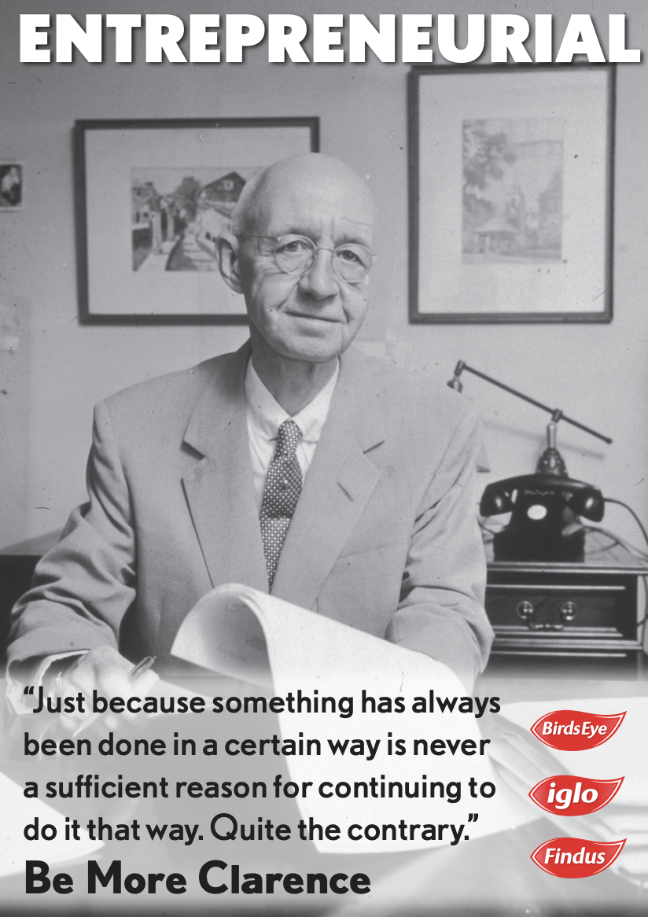
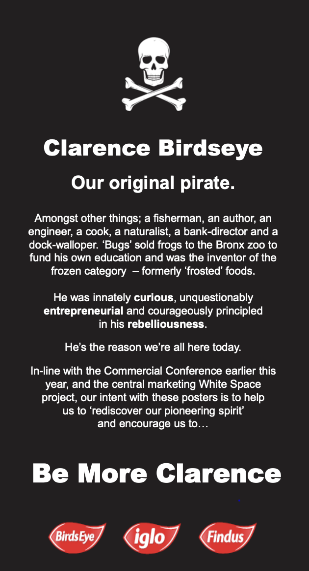
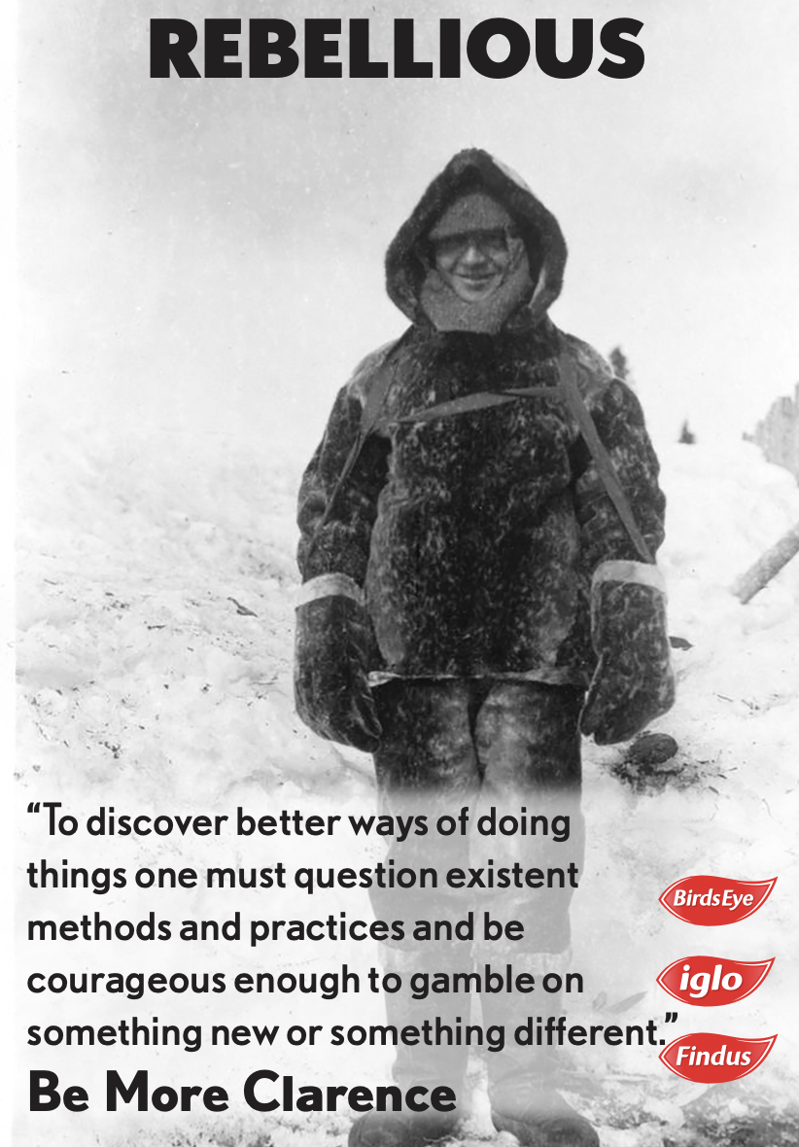

Slide 40
YOUR STORY IS
YOUR BEST WEAPON
Notes:
Now it’s up to you

Slide 41
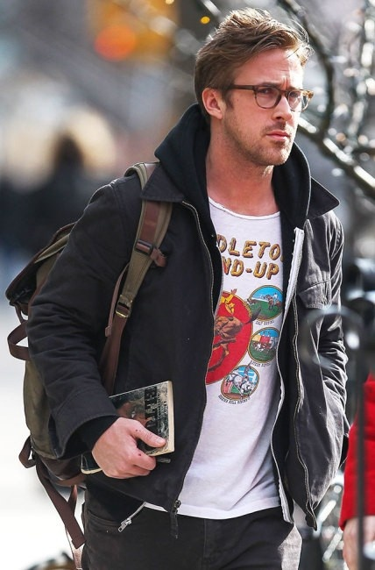
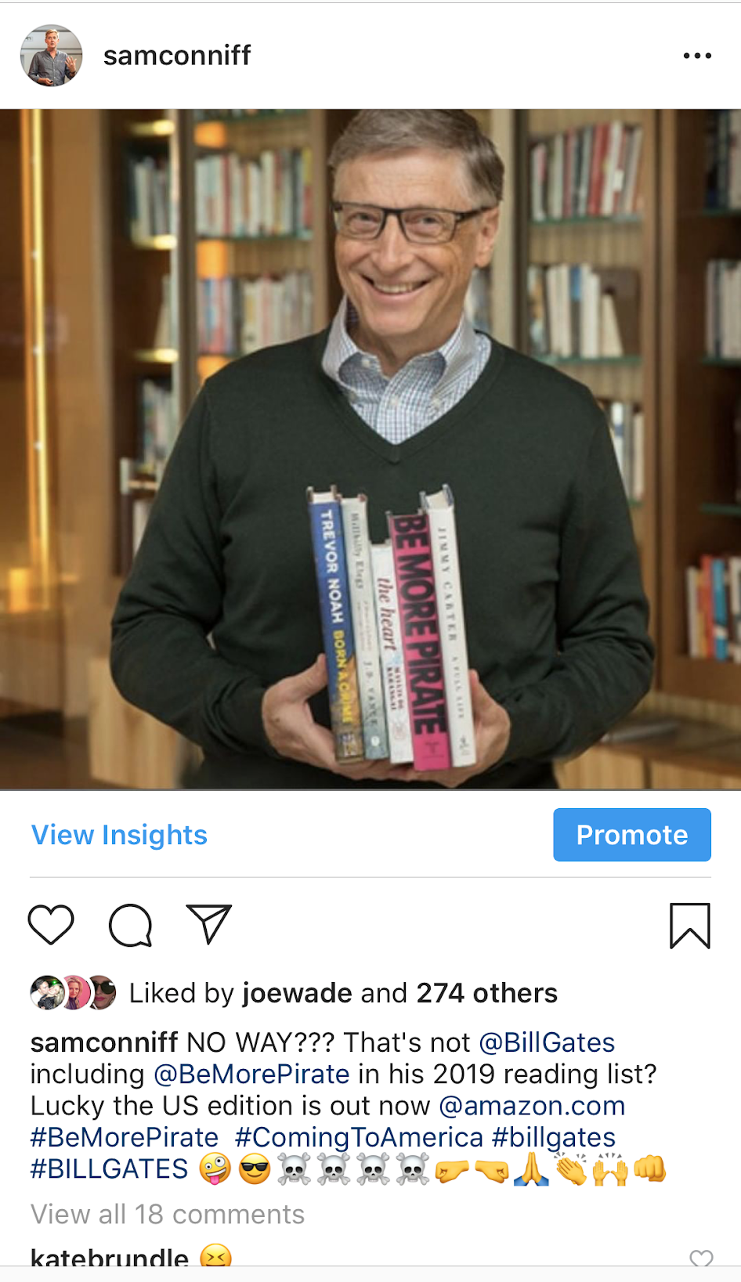
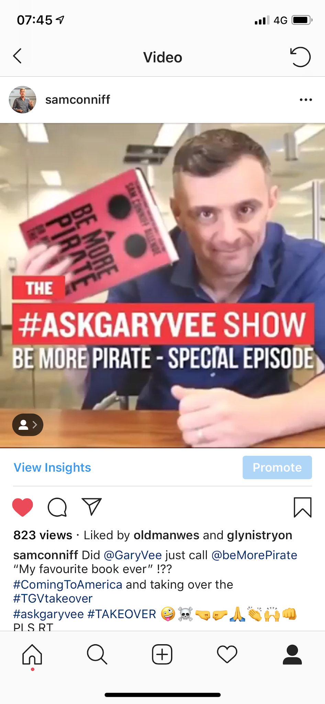
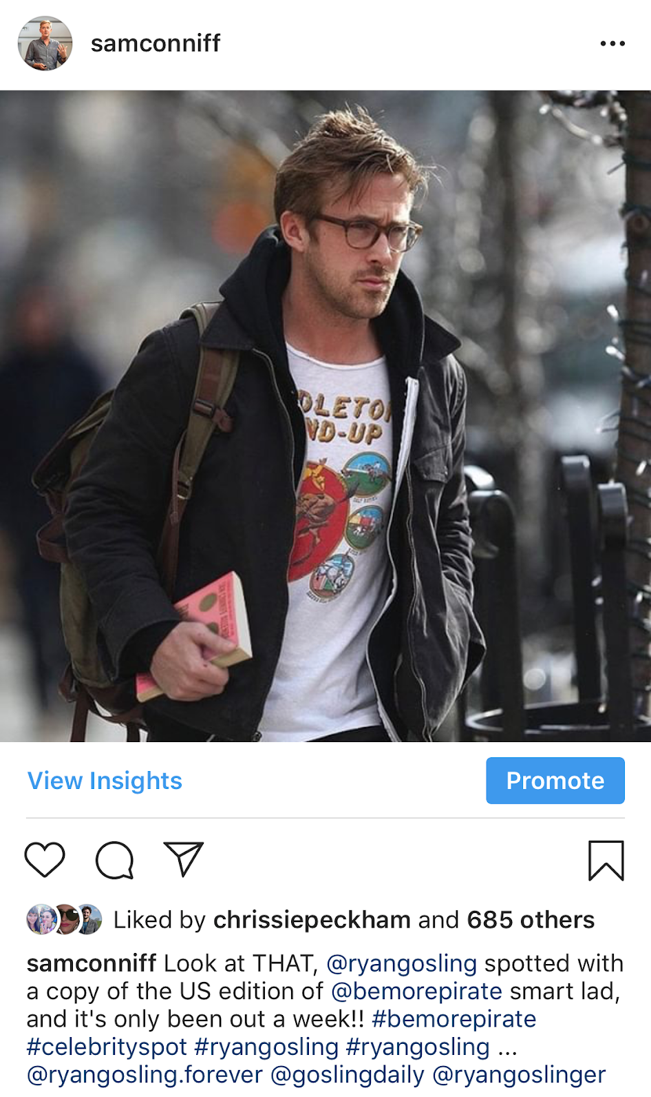
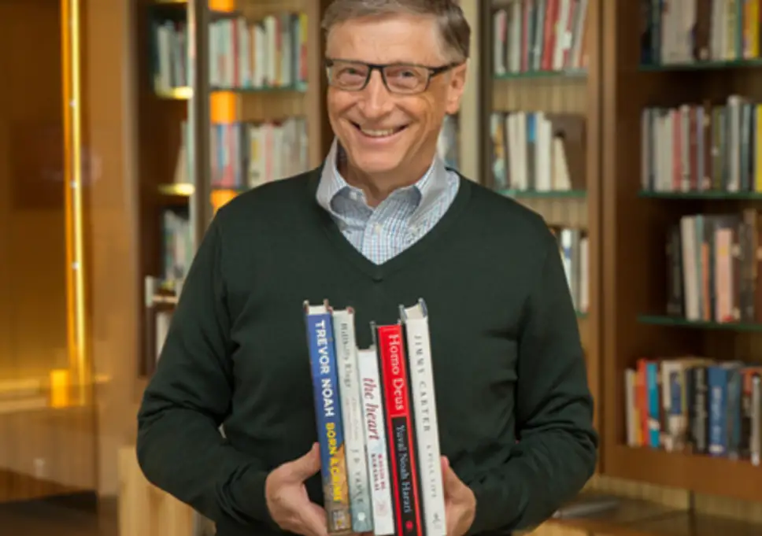
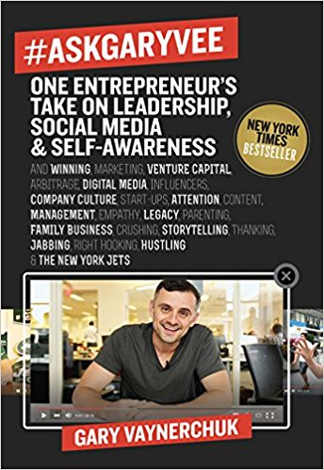
Notes:
Finally….Sam’s small bold action. When he got a US book deal, he was figuring out how to market over there so researched the biggest book readers (ie. people who publicaly promote what they’re reading). But…very difficult to actually get your book to them.
So he thought, hell why not just photoshop the book into their hands. This worked a treat and book sales spiked because a lot of people believed it was real. The captions are mean to show that its a parody (and he got legal advice beforehand), but essentially he just hired someone off fiverr to do it.

Slide 42
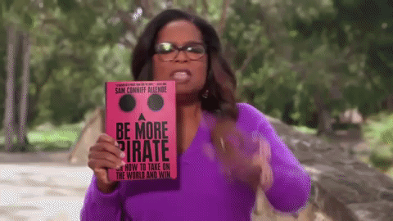
Notes:
The publishers were simultaneously pleased (with sales) and also said that he should take them down.
This is when Sam invented the pirate hack ‘when you hear no, sometimes you should pretend you heard go’
So he went one bigger…its still up on Instagram.
There were no bad consequences to this I should add. But, risk is subjective so everyone has to assess what feels bold for them personally. Don’t just copy someone elses. You have to find something that pushes you out of your comfort zone BUT doesn’t creat major anxiety or disasterous consequences

Slide 43
WHAT
WILL YOUR
NEW RULES BE?
Notes:
Now it’s up to you

Slide 44
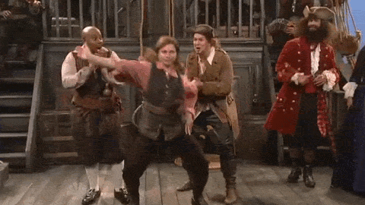
alex@bemorepirate.com

