Slide 1
Opening slide
NEUPC Connect
16 September 2026
“The State of Higher Education”
Ryan Keyworth
Chair of NEUPC and CFO, Sheffield Hallam

Slide 2
Basic University Finance Equation
Home UG should pay for itself (but not anymore)
Research doesn’t cover its costs (and never did)
International students generate a surplus
Other stuff like Halls should at least cover its costs

Slide 3
The theory doesn’t quite work in practice anymore...
Source: Annual TRAC data: Sector summary and analysis by TRAC peer group - Office for Students

Slide 4
Basic University Finance Equation
Home UG should pay for itself (but not anymore)
Research doesn’t cover its costs (and never did)
International students generate a surplus
Other stuff like Halls should at least cover its costs

Slide 5
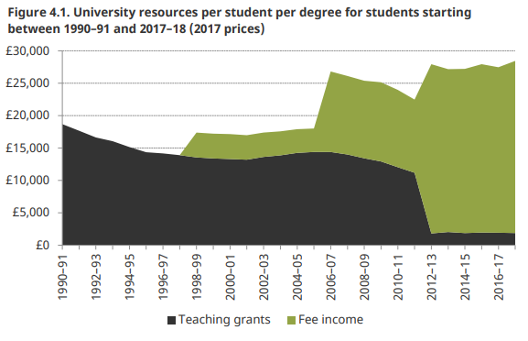
HE Finance Changes over time
Source: IFS - BN211.pdf (ifs.org.uk)
Notes:
Some remaining direct government support for “high-cost courses” – eg:
Clinical
Some sciences

Slide 6
Inflation hasn’t exactly been stable – CPI annual %
Source: ONS - CPIH INDEX 00: ALL ITEMS 2015=100

Slide 7
What is the £9k fee worth now?
Effect of Fee Inflation
Source: ONS - CPIH INDEX 00: ALL ITEMS 2015=100

Slide 8
What if Fees has risen by CPI Inflation?
Source: ONS - CPIH INDEX 00: ALL ITEMS 2015=100

Slide 9
Demographic Changes
Source: ONS - Subnational population projections for England: 2022-based

Slide 10
Demographic Changes
Source: ONS - Subnational population projections for England: 2022-based

Slide 11
Demographic Changes
Source: ONS - Subnational population projections for England: 2022-based

Slide 12
Basic University Finance Equation
Home UG should pay for itself (but not anymore)
Research doesn’t cover its costs (and never did)
International students generate a surplus
Other stuff like Halls should at least cover its costs

Slide 13
Research funding really doesn’t cover the cost of the activity...
Source: Annual TRAC data: Sector summary and analysis by TRAC peer group - Office for Students
Notes:
...and it varies a lot by
UK Research and Innovation (UKRI), the funder normally pays only 80% of the Full Economic Cost, with the university expected to cover the remaining 20%.
type of university

Slide 14
...and it’s different depending on where you are in the sector
Research fEC Recovery Rate (%)
TRAC Group | Description | %
A | Medical school institutions research income >20% of total income | 70
B | Research-intensive with research income >15% of total income | 64
C | Research income 5% to 15% of total income | 51
D | Research income <5%, total income >£150m | 44
E | Research income <5%, total income ≤£150m | 44
F | Specialist arts/music institutions | 60
Source: Annual TRAC data: Sector summary and analysis by TRAC peer group - Office for Students
Notes:
...and it varies a lot by
UK Research and Innovation (UKRI), the funder normally pays only 80% of the Full Economic Cost, with the university expected to cover the remaining 20%.
type of university

Slide 15
Basic University Finance Equation
Home UG should pay for itself (but not anymore)
Research doesn’t cover its costs (and never did)
International students generate a surplus
Other stuff like Halls should at least cover its costs

Slide 16
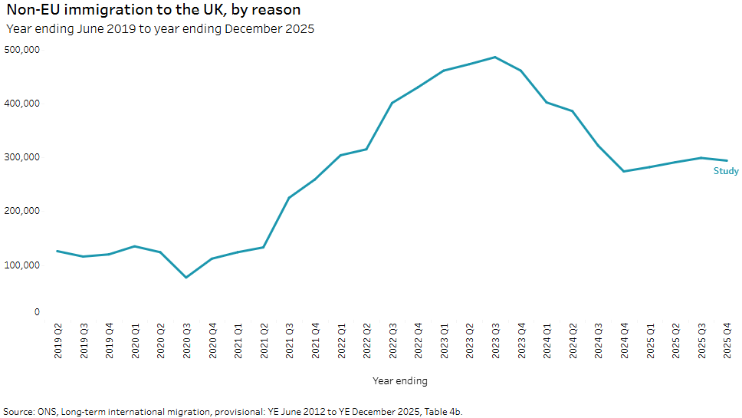
Overseas student numbers are volatile

Slide 17
...and fees vary widely
Typical International Fee
Oxbridge / Imperial | £35k-£60k+
Top Russell Group | £25k-£40k
Mid-tier Russell Group / research-intensive | £22k-£30k
Strong post-92 universities | £18k-£24k
Lower-tariff recruiting institutions | £16k-£20k
Notes:
Oxford charges almost £70k per year for the Clinical part of its medical course – that’s years 4, 5 and 6

Slide 18
...combine that with numbers, and income varies even more
 | Typical International Income
Oxbridge / Imperial | £300m - £1Bn+
Top Russell Group | £150m-£300m
Mid-tier Russell Group / research-intensive | £50m-£100m
Strong post-92 universities | £20m-£80m
Lower-tariff recruiting institutions | <£20m
Notes:
at UCL, international income is around £1Bn

Slide 19
...exposure to international fee risk can be very high
 | Proportion of income
Oxbridge / Imperial | around a half
Top Russell Group | about a third
Mid-tier Russell Group / research-intensive | about a quarter
Strong post-92 universities | a fifth or less
Lower-tariff recruiting institutions | less than a tenth

Slide 20
International overview
Fees are higher. In some cases, very high
Universities make a surplus on international...
...which covers losses on research and, in some cases, home students...
...but, numbers are variable over time
As a sector, we are very sensitive to changes in international numbers

Slide 21
...and we’re not operating in a stable policy environment
Policy | Year | Likely Impact on Recruitment
Restriction on student dependants | 2023/24 | Very Negative
Graduate Route review and uncertainty | 2024 | Medium Negative
Retention of Graduate Route | 2024 | Moderate Positive
Proposal to shorten Graduate Route to 18 months | 2025 | Very Negative
Tougher sponsor compliance regime | 2025-26 | Medium Negative
Proposed levy on international fee income | 2025 | Low direct / Moderate indirect

Slide 22
What we are seeing
Continued financial struggles across sector
Stalling participation rates and ongoing questioning of value of degree
Demographic growth to 2030 and then dip
Renewed focus on financial benefits of degree
All the above leading to an ever more dominant high-tariff group
LLE on the horizon
Skills levy taking shape
Regulation with “teeth” (TEF, limits on growth)

Slide 23
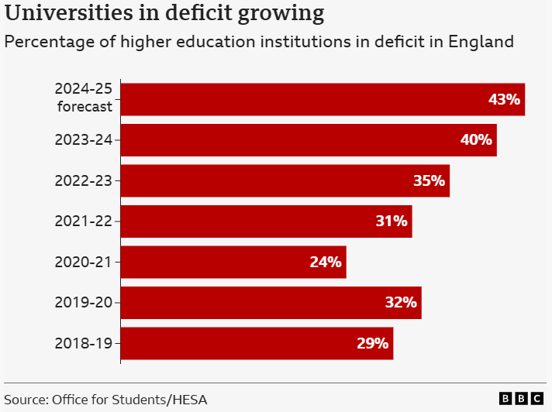
It boils down to an increasing number of universities reporting deficits

Slide 24
How are we responding?

Slide 25
The sorts of things universities are considering and / or already doing
Relatively quick Really long term
Voluntary Severance
Pay Cost Controls
Non-pay controls
Commercialisation / Consulting
Property sub-leasing
Commercial activity
International College
Franchise / TNE expansion
Academic Portfolio Review
Estates Rationalisation and Disposal
Target Operating Model
Outsourcing review
Sale and leaseback
Non-estate assets sale
JV / Partnership with other universities
Shared Services (eg IT, procurement)
Regional group structure / merger
Regional growth partnerships
Notes:
need to bring this back to the external context and strategy etc.
also, OIP

Slide 26


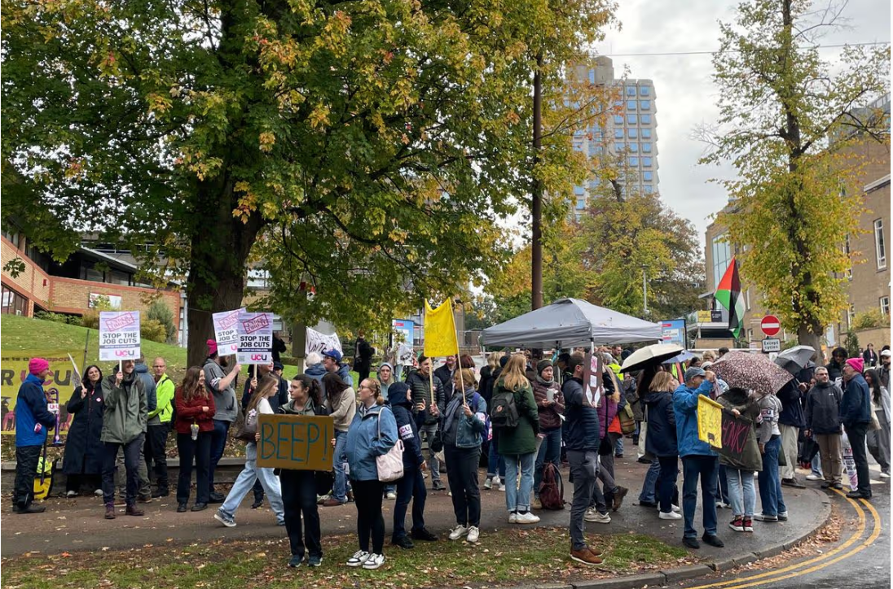
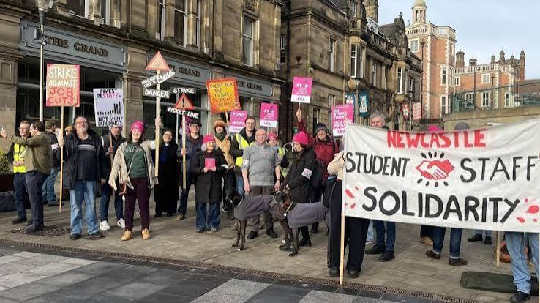

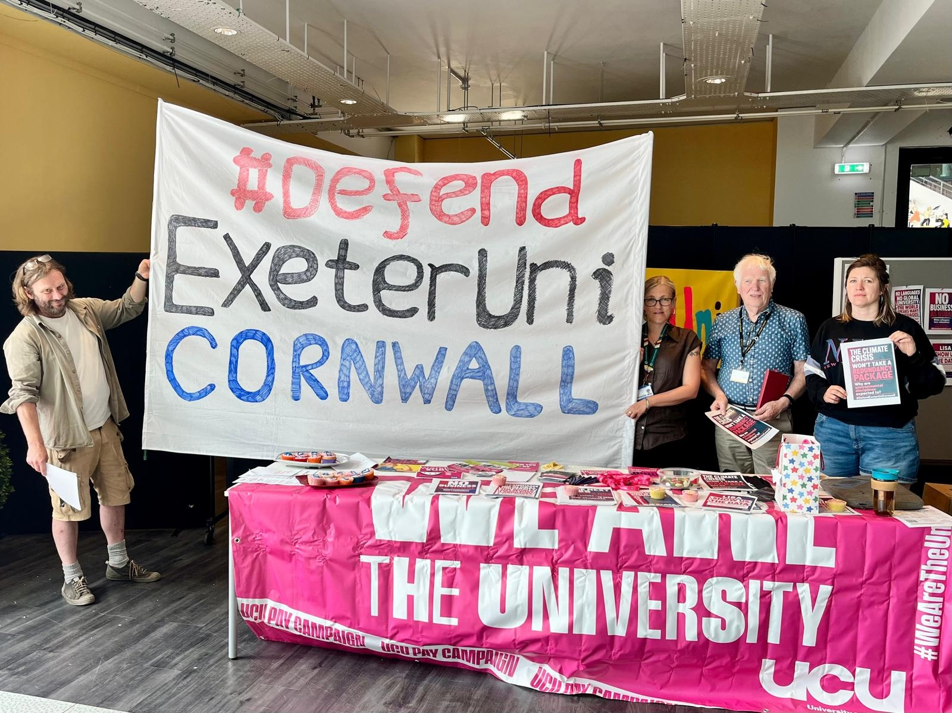
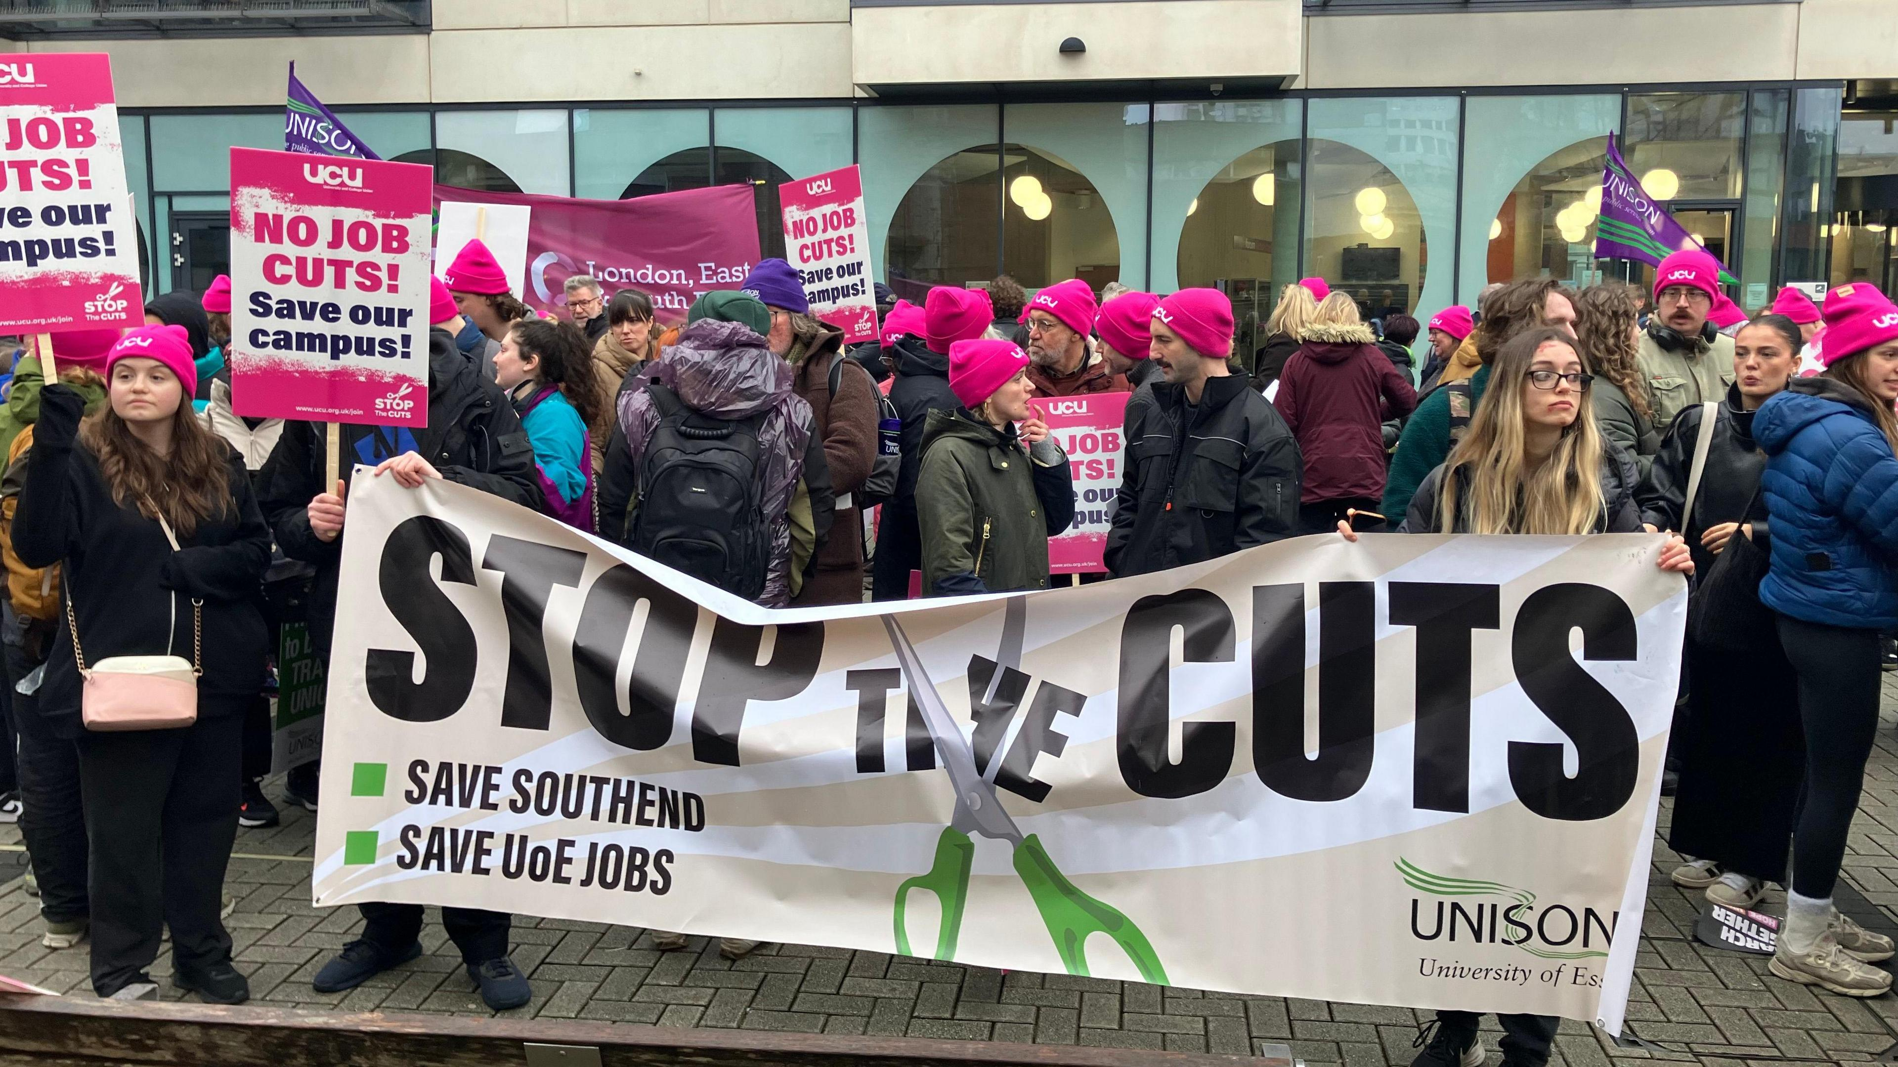
Job cuts across the sector

Slide 27
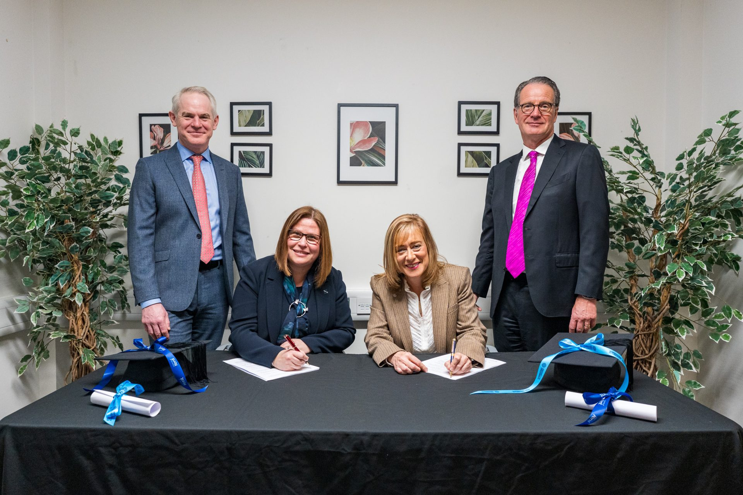
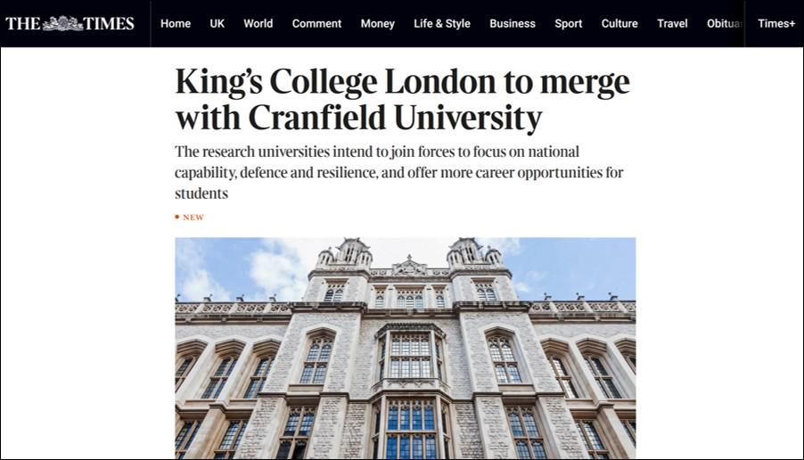
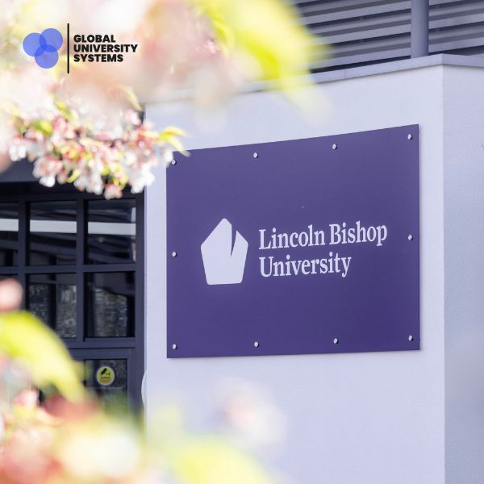

University “mergers” and “acquisitions”

Slide 28
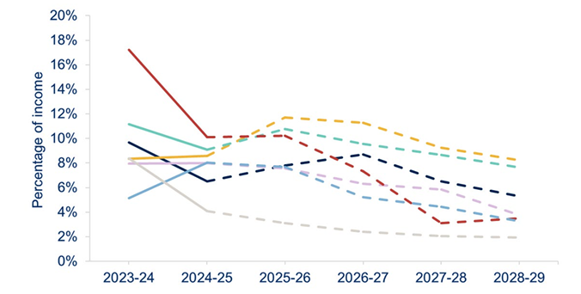
...Investment is generally reducing – a sign of belt-tightening
Capital expenditure as a percentage of total income by provider group, 2023-24 to 2028-29
Source: OfS Financial sustainability of higher education providers in England: 2026

Slide 29
There’s a risk that we’re not learning fast enough...

Slide 30
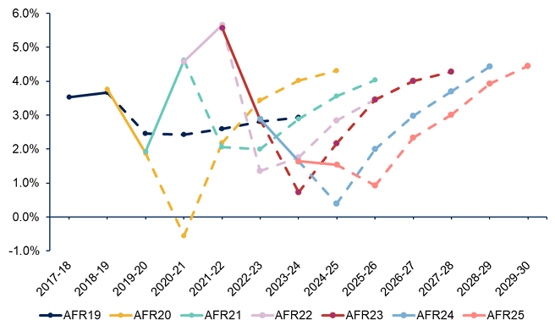
There’s a lot of risk in our forecasting – and it’s not a new thing
Surplus/deficit as a percentage of total income
Source: OfS Financial sustainability of higher education providers in England: 2026
Notes:
This is a complex chart, but it tells a worrying story and one you might recognise from your own university.
Each lineis a combination of actual and forecast.
There is a new line for each year, starting in 2019.
Each line shows the actuals up to the year of the line and then the forecast from that year.
The point here is that in aggregate, we are consistently forecasting for better performance than current
Given what we’ve seen, that looks ambitious at best and incredibly risky at worst.

Slide 31
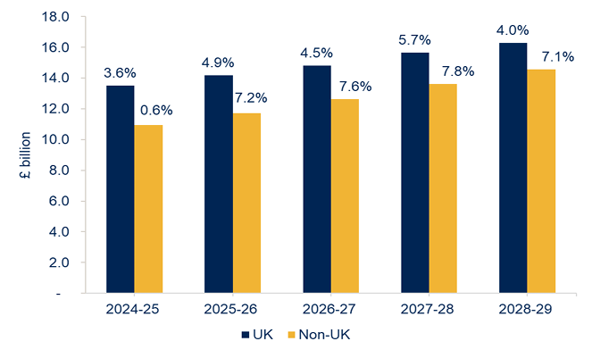
...there’s a lot of optimism still in the system
Forecast tuition fee income and annual change by domicile, 2024-25 to 2028-29
Source: OfS Financial sustainability of higher education providers in England: 2026
Notes:
In aggregate, we’re expecting both domestic and international income to increase over time – we can’t all “win”

Slide 32
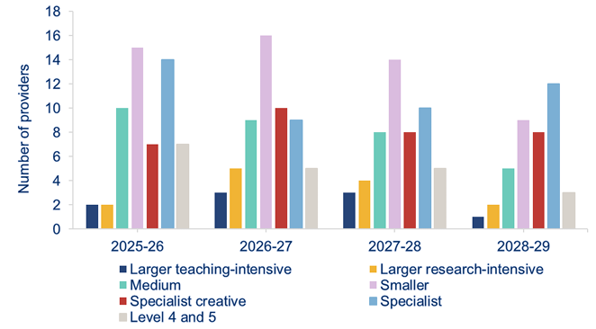
...and even with that optimism, there are a lot of challenges out there
Number of providers forecasting three-year consecutive deficits, 2025-26 to 2028-29
Source: OfS Financial sustainability of higher education providers in England: 2026
Notes:
Still a lot predicting three years of consecutive deficits – with some having a lot more than that

Slide 33
The State of the Sector
Quite a lot of risk – and a lot more than most of us have seen
  Home undergraduate
  Research
  International
Still not consistently acknowledging the position we’re in
Optimistic forecasting / not facing up to the reality we’re in?

Slide 34
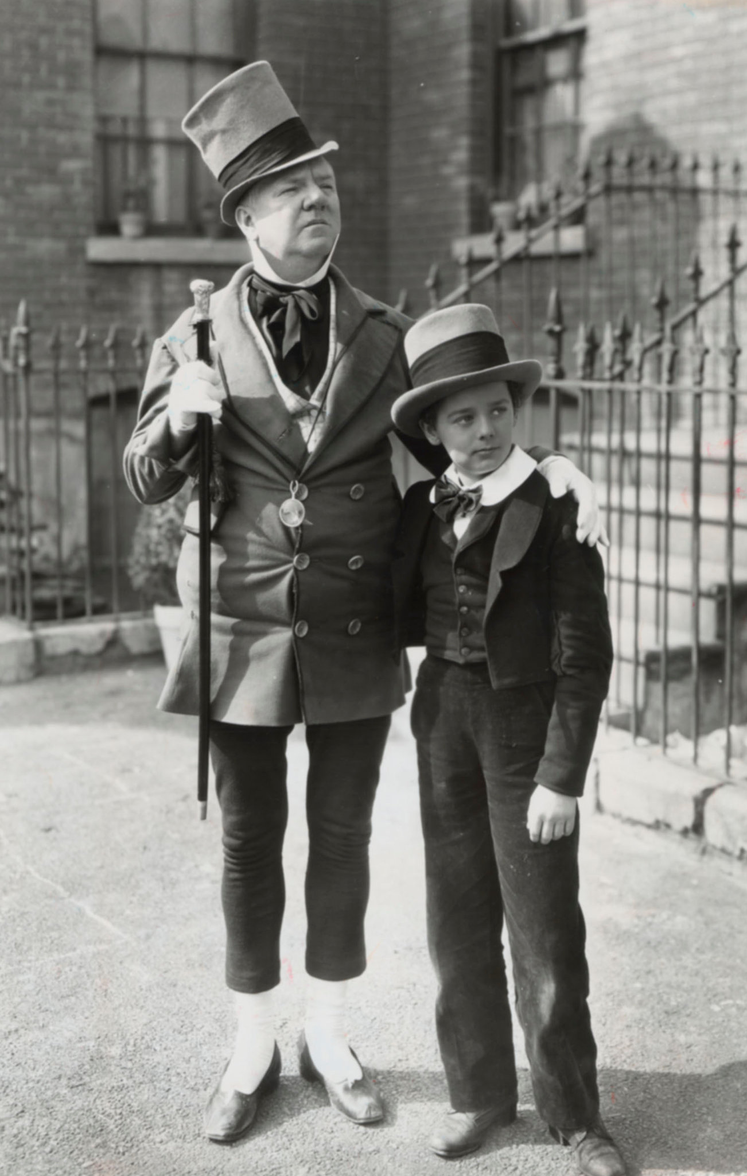
Role of University CFO
Sometimes it can be a bit binary
OfS Condition D
The provider must:
Be financially viable
Be financially sustainable
Have the necessary financial resources to provide and fully deliver the higher education courses as it has advertised and as it has contracted to deliver them
Have the necessary financial resources to continue to comply with all conditions of its registration
Sources: Picture- Debt’s Two Sides: Riches and Misery - The New York Times (nytimes.com)
Conditions of registration - Office for Students
Notes:
Wilkins Micauber from David Copperfield –
"Annual income twenty pounds, annual expenditure nineteen pounds nineteen and six, result happiness. Annual income twenty pounds, annual expenditure twenty pounds ought and six, result misery."

Slide 35
So what does it mean for NEUPC and all of us?
There’s a lot to go at, even if only a fraction of this is “influenceable”
Non-pay spend £ / % | £ | %
Oxbridge / Imperial | £600m-£800m | 45%+
Top Russell Group | £500m-£600m | c.45%
Mid-tier Russell Group | £300m-£400m | 42%-48%
Strong post-92 universities | c.£200m | c.40%
Lower-tariff recruiting institutions | <£100m | 30%-40%

Slide 36
A few thoughts from me...
Too often, procurement is an afterthought | How are you looking to change this? How can we work together to amplify the voice of procurement and reposition your level of influence within your institutions?
Too often, procurement is transactional | How are you developing the maturity of the procurement functions to adopt and exploit the new flexibilities within the regulations If you’re not subject to them, what flexibility have you been able to exploit that potentially the rest of us can benefit from?
Too often, universities act on their own, rather than acting together | How can we better collaborate with each other Shared learning from competitive flexible processes? Case studies? Aggregation of spend?

Slide 37
Opening slide
Questions?

