Slide 1
Getting the most out of your contracts
NEUPC Connect
16th September 2026
Kieran McGaughey, Consultant Solicitor

Slide 2
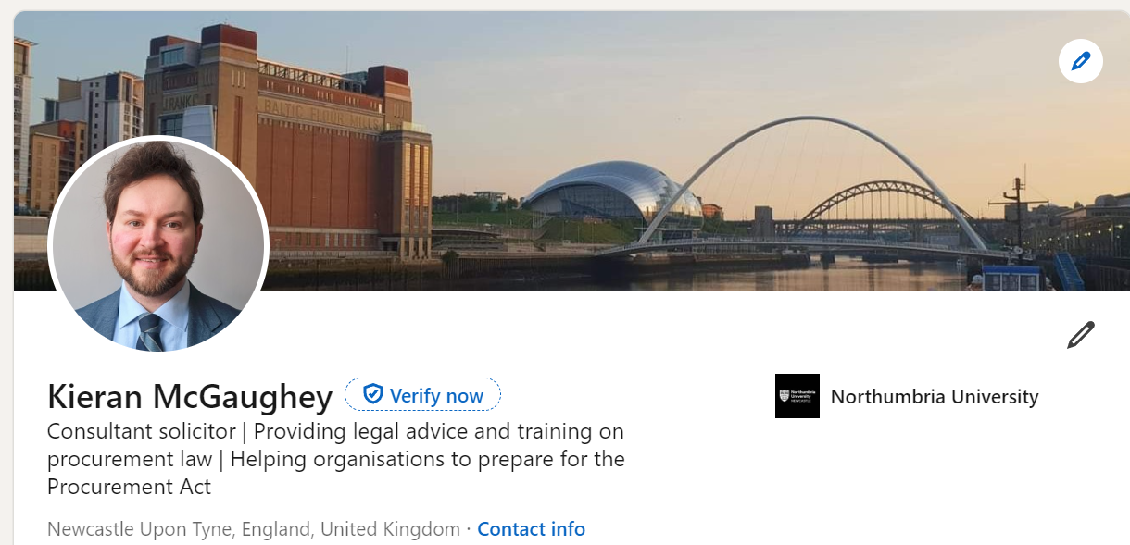
Introduction…
Kieran McGaughey, Consultant Solicitor

Slide 3


Agenda
Scene setting: Why is contract management important?
The benefits of pre-market engagement
Selecting the right supplier
Getting the right contract terms
Key Performance Indicators (“KPIs”)
Practical tips on contract management
Audience Q and A
Kieran McGaughey, Consultant Solicitor

Slide 4
Key:
Any wording coloured green like this only applies to contracting authorities (universities/others who are subject to public procurement law)
Everything else applies to any organisation procuring/managing contracts
Kieran McGaughey, Consultant Solicitor

Slide 5
Contract management - why does it matter?
Enables you to monitor whether the supplier is complying with the contract terms (including the terms and conditions, but also the specification and their tender response)
Managing that performance then helps ensure the outcomes in your specification are achieved
You can address small issues before they become big issues!
Positive supplier relationship more likely to lead to positive outcomes for your university
Kieran McGaughey, Consultant Solicitor

Slide 6
Contract management - why does it matter?
- Increases the chance of having early sight of problems (supplier in financial distress etc)
- Enables you to realise when changes are needed to the contract (certain rules about this if you are a contracting authority governed by public procurement law)
- New legal requirements under the Procurement Act regarding transparency (as above, for in-scope authorities)
Kieran McGaughey, Consultant Solicitor

Slide 7
The benefits of pre-market engagement
✅ It helps publicise the procurement and generate interest (this alone is perhaps reason to do it)
✅ It gives bidders more time to prepare their bid
✅ It can provide valuable networking opportunities for bidders - consortium bidding, subcontracting etc.
✅ You can understand the challenges, risks and opportunities associated with the procurement from a bidder's perspective. Is your draft specification clear enough? Are your proposed KPIs achievable? Are your draft contract terms commercially acceptable? (see later also on these topics)
Kieran McGaughey, Consultant Solicitor

Slide 8
The benefits of pre-market engagement
✅ It allows the market to talk to you - remember, pre-market engagement should be a two-way street. Valuable feedback from the market can shape your requirements (and for contracting authorities which procedure (open or competitive flexible) you decide to use). It can also help inform decisions about lotting etc.
✅ For contracting authorities, it allows you to talk to the market in a less regulated environment. If those conversations are taking place post-tender for example (and the supplier is asking to change things late in the day), there is a completely different risk profile.
Kieran McGaughey, Consultant Solicitor

Slide 9
The benefits of pre-market engagement
✅ You begin to gain a better understanding of how much the contract(s) might cost (this has can help prevent the need to abandon (cancel) the procurement)
✅ You start to ascertain what award criteria and social value might be appropriate
✅ Are there other ways of solving your identified problem/need? Bidders could propose alternatives you might not have considered. They are the experts after all!
Kieran McGaughey, Consultant Solicitor

Slide 10
Selecting the right supplier – practical tips…
✅ Pre-market engagement
✅ Clear, detailed specification
✅ Weightings (price/quality/social value) which reflect what’s important to you
✅ Carefully crafted evaluation questions
✅ A scoring matrix which allows you to differentiate between bids
✅ Fair contract terms (see later)
Kieran McGaughey, Consultant Solicitor

Slide 11
Getting the right contract terms – why does it matter?
Has your university ever:
Had a supplier bump their prices up?
Had a supplier introduce new charges which weren't in the original quote?
Forgot to cancel a contract leading to it automatically rolling over?
Received poor service but had limited rights under the contract to do anything about it?
Wanted to terminate a contract early but faced significant cost penalties for doing so?
^ These examples illustrate why getting the right contract terms is vitally important!
Kieran McGaughey, Consultant Solicitor

Slide 12
Getting the right contract terms – why does it matter?
The contract establishes the rules of the relationship, including the roles and responsibilities of each party
Suitable contract terms will protect the university's interests
Can help to ensure legal compliance – for example prompt payment obligations for contracting authorities
Suitable contract terms will also help avoid bidders:
(a) Declining to bid;
(b) "Pricing up" for risk; and/or
(c) Attempting to negotiate terms post-deadline
Kieran McGaughey, Consultant Solicitor

Slide 13

Key battlegrounds...
Liability caps
Indemnities
Intellectual property rights
Termination rights
Price increases
Automatic renewals
Kieran McGaughey, Consultant Solicitor

Slide 14
Contract terms
Why does it matter what contract terms you use?
Some typical characteristics…
University standard terms | Supplier standard terms
Pro-customer | Pro-supplier
Fixed term | May contain automatic renewal provisions
Fixed price (or limited scope for price increases, tied to an index etc) | May contain unrestricted ability for supplier to increase price
Greater protection – indemnities in the university’s favour, high/uncapped liability | Limited protection – few/no indemnities, liability may be capped to annual fees
Will generally require a high standard of services/goods | May attempt to exclude implied terms around quality, reasonable skill and care etc
Various contractual termination rights | Limited contractual termination rights
Kieran McGaughey, Consultant Solicitor

Slide 15
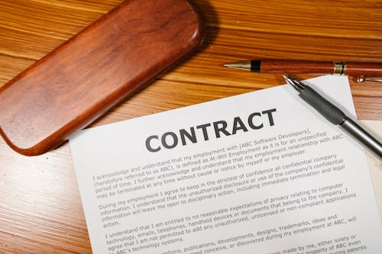
Scenario 1: the university’s terms are the starting point
<<< Pro-customer contract terms Pro-supplier contract terms >>>
Supplier negotiation >>>
Agreed final version
<<< Pro-customer contract terms Pro-supplier contract terms >>>
Kieran McGaughey, Consultant Solicitor

Slide 16
Scenario 2: the supplier’s terms are the starting point
<<< Pro-customer contract terms Pro-supplier contract terms >>>
Agreed final version
<<< University negotiation
<<< Pro-customer contract terms Pro-supplier contract terms >>>
Kieran McGaughey, Consultant Solicitor

Slide 17
Key Performance Indicators (KPIs): where should you set the bar?
Too high? Risks: bidders don’t bid, “price up”, or seek to renegotiate before signing the contract (for contracting authorities potentially problematic in light of new contract publication requirements)
Too low? doesn’t drive high standards, arguably doesn’t promote value for money etc
Kieran McGaughey, Consultant Solicitor

Slide 18
Setting and managing KPIs: top tips!
Set KPIs which are capable of objective measurement (“SMART” approach – Specific, Measurable, Achievable, Realistic, Time Bound)
Talk to the market to assist with the above – for example, sharing draft KPIs for comment during pre-market engagement
Look at what KPI others have set (and, in due course, how performance is going against those KPIs – new contract performance notices)
Look at performance of your existing contracts
Send the supplier regular notifications detailing KPI performance
Kieran McGaughey, Consultant Solicitor

Slide 19
A tale of two contract managers…
Contract Manager A: David
Was already overstretched
Has never received any training on contract management
Wasn’t involved in the original procurement
Doesn’t actually have a copy of the contract
Avoids engaging with the supplier unless he really has to
All contact verbal (phones calls
etc) - limited record keeping
Contract Manager B: Zara
Job role takes account of the time needed to manage the contract
Has received training on effective contract management
Helped draft the specification, and
was an evaluator
Regularly consults the contract terms (including spec/tender response)
Meets regularly with the supplier
Written records exist (emails, meeting minutes etc)
Kieran McGaughey, Consultant Solicitor

Slide 20
Top tips…
Kieran McGaughey, Consultant Solicitor

Slide 21

Contract management: top tips
- It’s all about relationships – regular dialogue/meetings, honest conversations at an early stage
- Contract manager needs to:
have appropriate resources
understand their role
understand the key elements of the contract (including the spec)
Kieran McGaughey, Consultant Solicitor

Slide 22
Contract management: top tips!
✅ Get the right contract manager
✅ Get them involved early
✅ Training
✅ Know the contract
✅ Diary management
✅ Regular dialogue
✅ Build rapport
✅ Be assertive!
✅ Work the contract!
✅ Document changes
✅ Seek legal advice

Slide 23
Ways to achieve better contract management
Rules - Set requirements in your internal rules – for example, as a basic starting point, every contract must have a named contract manager
Education - Make the relevant stakeholders aware of those rules, and why contract management is important. Handover pack from procurement to delivery teams
Training - Train those contract managers (and procurement staff)
Processes – For contracting authorities helps ensure the relevant notices are being published (contract change notices, contract performance notices etc)
Internal discussion and debate - Share ideas and knowledge. For example, what has/hasn’t worked well when setting KPIs
Kieran McGaughey, Consultant Solicitor

Slide 24
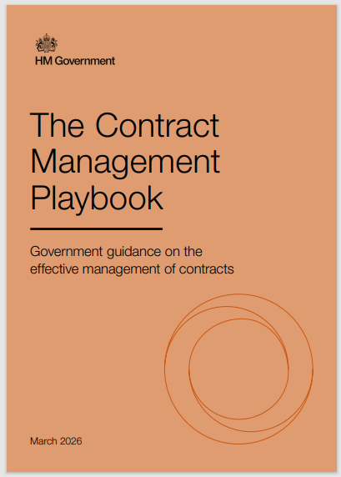
The Contract Management Playbook
Kieran McGaughey, Consultant Solicitor

Slide 25
Final thoughts….
Take contract management seriously – failures can lead to lost value, or even litigation/negative publicity (particularly for contracting authorities)
Consider the use of KPIs to drive high performance. Ensure standard terms and conditions cross-reference KPIs.
Training is a great way to get on top of contract management – train contract managers on how to undertake their role effectively.
Kieran McGaughey, Consultant Solicitor

Slide 26

Any questions?
Kieran McGaughey, Consultant Solicitor
Kieran McGaughey, Consultant Solicitor

Slide 27
Thank you for listening!
Feel free to keep in touch – you can connect on LinkedIn here: https://uk.linkedin.com/in/kieran-mcgaughey-29383b66
Contact details: kieranmcgaughey@hotmail.com
Kieran McGaughey, Consultant Solicitor

